Slide 1
Path & Reachability (Cont)
COMP9312_22T2

Slide 2
Outline
- Reachability
Transitive closure
Optimal Tree cover
Two-Hop labelling
- Shortest Path
Dijkstra’s algorithm
A* algorithm
Floyd-Warshall algorithm

Slide 3
Shortest Distance/Path

Slide 4
Shortest path
1. Single-source shortest path problem (finding the shortest paths between a given vertex v and all other vertices in the graph)
- BFS
- Dijkstra’s algorithm (very similar to Prim’s algorithm; assumes all weights are positive)
- If we only want to find the shortest path to one given goal node, A* algorithm
2. All pair shortest path (find the pairwise shortest distances as well as the corresponding paths)
- Floyd-Warshall algorithm

Slide 5
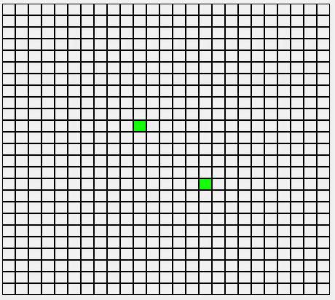
BFS-based shortest path
Find the shortest path from vertex u to v.
A naive BFS-based approach:
(1) conduct a BFS from the source vertex u
(2) for each visited vertex, record its parent in the searching tree
(3) when the target vertex v is visited, terminate BFS.
(4) recursively return the path from u to v.
Notes:
Intuitively, if we want to know the shortest distance from u to v.
We can extend the BFS algorithm in graph traversal to solve this problem.
We simply need to specify that:
when v is visited, terminate the BFS process and return the depth as the shortest distance.
For each vertex, we use an array to record its parent vertex in the searching tree.

Slide 6
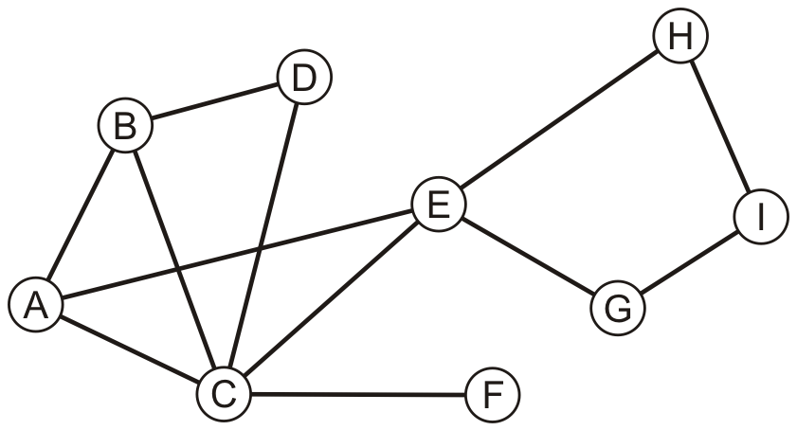
Example
Find the shortest path from A to D by performing a breadth-first traversal
Push the first vertex A into the queue:
A

Slide 7
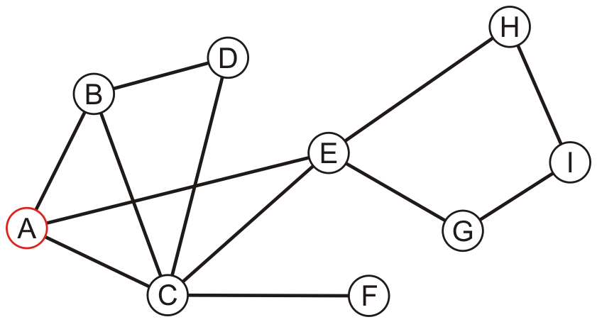
Example
Pop A and push B, C, E.
Parents of visited vertices:
B: A
C: A
E: A
B | C | E

Slide 8
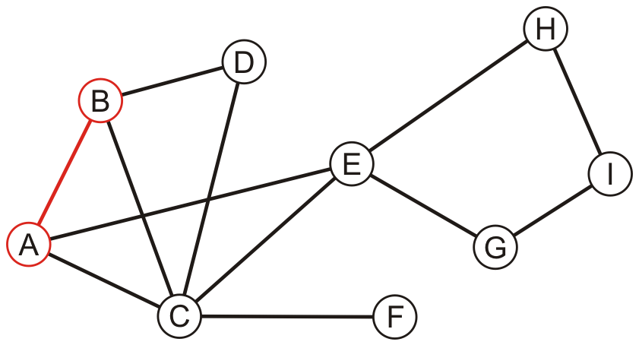
Example
Pop B and push D into the queue.
Since D is found, terminate BFS! Based on the recorded parent vertices, one shortest path is A->B->D.
Parents of visited vertices:
B: A
C: A
D: B
E: A
C | E | D

Slide 9
BFS-based shortest path
Question:
1. Can we guarantee that this path is the shortest? If so, is it the only shortest path?
2. Time complexity? Space complexity?
3. Can we use the above algorithm to solve the single-source shortest path problem and the all pairs shortest path problem?
Yes, we can. No, in the above example, A->C->D is another path with length 2.
The time complexity is O(m) which is the same with BFS. Slightly faster in practice because of the early termination. The space complexity is O(n) since we need to record the parent vertex of each visited vertex.
Yes.
Notes:
Yes, we can. This is because in BFS, we always visit the d-hop neighbors before we visit any d+1 hop neighbors.
No, in the above example, A->C->D is another path with length 2.
The above algorithm can only return one possible shortest path. There can be other shortest paths.
2. The time complexity is O(m) which is the same with BFS. Slightly faster in practice because of the early termination. The space complexity is O(n) since we need to record the parent vertex of each visited vertex.
3. If we naively extend this online method to solve single-source shortest path problem and the all pairs shortest path problem, the time complexity is too cost-prohibitive.

Slide 10
Dijkstra’s Algorithm

Slide 11
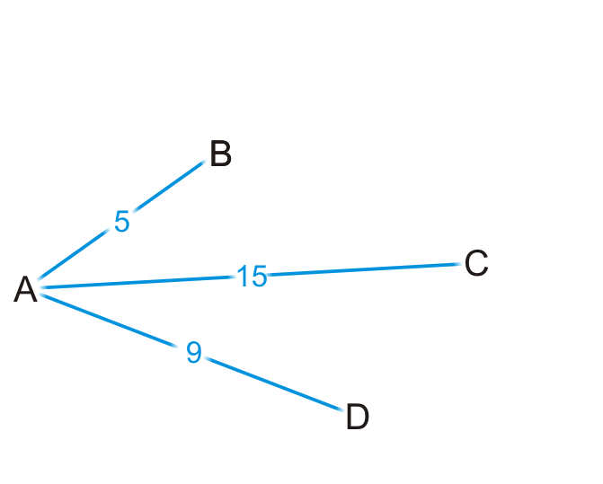
Motivation
Single-source shortest path problem (finding the shortest paths between a given vertex v and all other vertices in the graph)
Suppose you are at vertex A
You are aware of all vertices adjacent to it
This information is either in an adjacency list or adjacency matrix
Q: Is 5 the shortest distance to B via the edge (A, B)?
Q: Are you guaranteed that the shortest path to C is (A, C), or that (A, D) is the shortest path to vertex D?
Notes:
These slides are the motivation for the Dijkstra’s algorithm
Yes, it is. Because there cannot be a path A->u->B such that the sum of weights is less than 5.
Since 5 is the least weight.
Q1: YES
Q2: NO

Slide 12
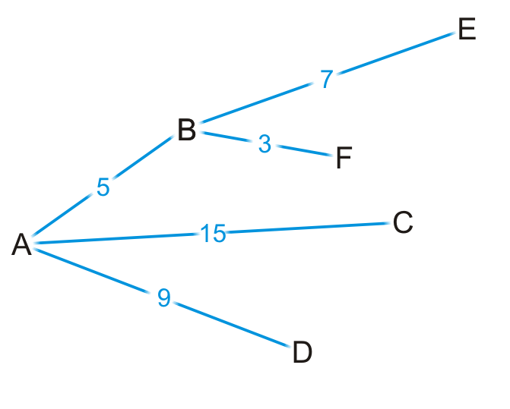
Motivation
Let’s see where we can go from B
By some simple arithmetic, we can determine that
There is a path (A, B, E) of length 5 + 7 = 12
There is a path (A, B, F) of length 5 + 3 = 8

Slide 13
Motivation
Is (A, B, F) is the shortest path from vertex A to F?
Why or why not?
Yes, because 5+3<9, 5+3<15, and 3 is the smallest weight from B.
Notes:
Yes, because 5+3<9, 5+3<15

Slide 14
Motivation
Are we guaranteed that any other path we are currently aware of is also going to be the shortest path?
No.
Notes:
No.

Slide 15
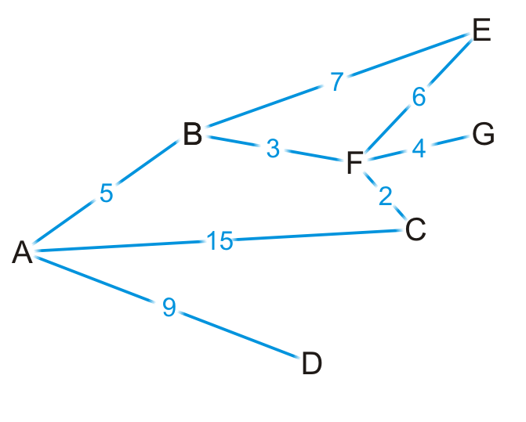
Motivation
Okay, let’s visit vertex F
We know the shortest path is (A, B, F) and it’s of length 8

Slide 16
Motivation
There are three edges exiting vertex F, so we have paths:
(A, B, F, E) of length 8 + 6 = 14
(A, B, F, G) of length 8 + 4 = 12
(A, B, F, C) of length 8 + 2 = 10

Slide 17
Motivation
By observation:
The path (A, B, F, E) is longer than (A, B, E)
The path (A, B, F, C) is shorter than the path (A, C)

Slide 18
Motivation
At this point, we’ve discovered the shortest paths to:
Vertex B: (A, B) of length 5
Vertex F: (A, B, F) of length 8

Slide 19
Motivation
At this point, we have the shortest distances to B and F
Which remaining vertex are we currently guaranteed to have the shortest distance to?
D. Because D is the unvisited vertex which has the shortest distance right now.
Notes:
ANS: vertex D. Because D has the shortest distance right now.

Slide 20
Dijkstra’s algorithm
Like Prim’s algorithm, we initially don’t know the distance to any vertex except the initial vertex. Thus, we require an array of distances, all initialized to infinity except for the source vertex, which is initialized to 0.
Each time we visit a vertex, we will examine all adjacent vertices.
We need to track visited vertices—a Boolean table of size |V|
How to track the shortest path to each vertex?
Do I have to store (A, B, F) as the shortest path to vertex F?
We really only have to record that the shortest path to vertex F came from vertex B
We would then determine that the shortest path to vertex B came from vertex A
Thus, we need an array of previous vertices, all initialized to null

Slide 21
Dijkstra’s algorithm
We will iterate |V| times:
Find that unvisited vertex v that has a minimum distance to it. Mark it as having been visited.
Consider every adjacent vertex w that is unvisited:
- Is the distance to v plus the weight of the edge (v, w) less than our currently known shortest distance to w. If so, update the shortest distance to w and record v as the previous pointer.
Continue iterating until all vertices are visited or all remaining vertices have a distance to them of infinity.

Slide 22
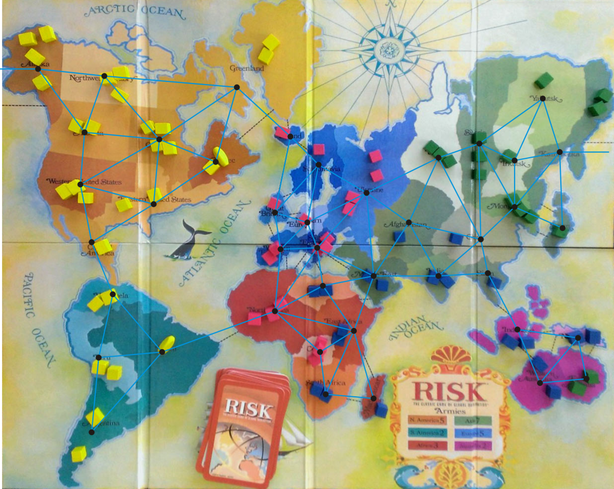
Example
Consider the game of Risk from Parker Brothers
A game of world domination
The world is divided into 42 connected regions
The regions are vertices and edges indicate adjacent regions

Slide 23
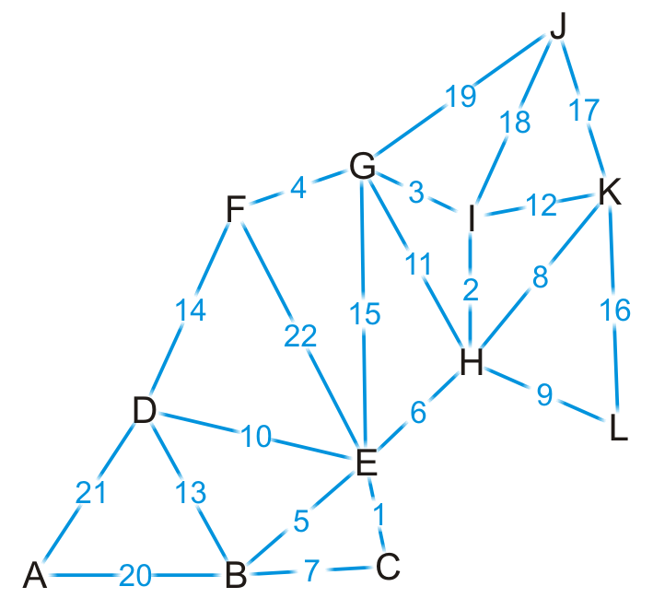
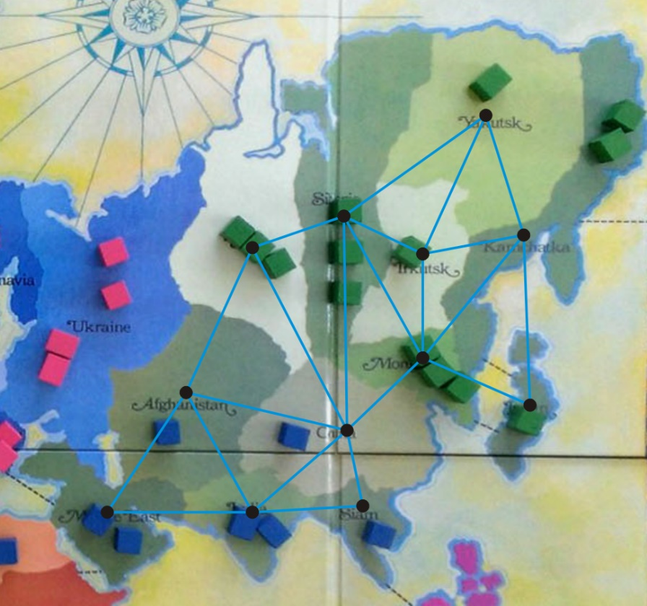
Example
We’ll focus on Asia. Here is our abstract representation.
Let us give a weight to each of the edges.
Find the shortest distance from Kamchatka (K) to every other region
http://thunderbird37.com/tag/paker-brothers/

Slide 24
Example
We set up our table as follows.
Vertex | Visited | Distance | Previous
A | F | ∞ | Ø
B | F | ∞ | Ø
C | F | ∞ | Ø
D | F | ∞ | Ø
E | F | ∞ | Ø
F | F | ∞ | Ø
G | F | ∞ | Ø
H | F | ∞ | Ø
I | F | ∞ | Ø
J | F | ∞ | Ø
K | F | 0 | Ø
L | F | ∞ | Ø

Slide 25
Example
We visit vertex K
Vertex | Visited | Distance | Previous
A | F | ∞ | Ø
B | F | ∞ | Ø
C | F | ∞ | Ø
D | F | ∞ | Ø
E | F | ∞ | Ø
F | F | ∞ | Ø
G | F | ∞ | Ø
H | F | ∞ | Ø
I | F | ∞ | Ø
J | F | ∞ | Ø
K | T | 0 | Ø
L | F | ∞ | Ø

Slide 26
Example
Vertex K has four neighbors: H, I, J and L
Vertex | Visited | Distance | Previous
A | F | ∞ | Ø
B | F | ∞ | Ø
C | F | ∞ | Ø
D | F | ∞ | Ø
E | F | ∞ | Ø
F | F | ∞ | Ø
G | F | ∞ | Ø
H | F | ∞ | Ø
I | F | ∞ | Ø
J | F | ∞ | Ø
K | T | 0 | Ø
L | F | ∞ | Ø

Slide 27
Example
We have now found at least one path to each of these vertices
Vertex | Visited | Distance | Previous
A | F | ∞ | Ø
B | F | ∞ | Ø
C | F | ∞ | Ø
D | F | ∞ | Ø
E | F | ∞ | Ø
F | F | ∞ | Ø
G | F | ∞ | Ø
H | F | 8 | K
I | F | 12 | K
J | F | 17 | K
K | T | 0 | Ø
L | F | 16 | K

Slide 28
Example
We’re finished with vertex K.
To which vertex are we now guaranteed we have the shortest path?
Vertex | Visited | Distance | Previous
A | F | ∞ | Ø
B | F | ∞ | Ø
C | F | ∞ | Ø
D | F | ∞ | Ø
E | F | ∞ | Ø
F | F | ∞ | Ø
G | F | ∞ | Ø
H | F | 8 | K
I | F | 12 | K
J | F | 17 | K
K | T | 0 | Ø
L | F | 16 | K

Slide 29
Example
We visit vertex H: the shortest path is (K, H) of length 8
Vertex H has four unvisited neighbors: E, G, I, L
Vertex | Visited | Distance | Previous
A | F | ∞ | Ø
B | F | ∞ | Ø
C | F | ∞ | Ø
D | F | ∞ | Ø
E | F | ∞ | Ø
F | F | ∞ | Ø
G | F | ∞ | Ø
H | T | 8 | K
I | F | 12 | K
J | F | 17 | K
K | T | 0 | Ø
L | F | 16 | K

Slide 30
Example
Consider these paths:
(K, H, E) of length 8 + 6 = 14 (K, H, G) of length 8 + 11 = 19
(K, H, I) of length 8 + 2 = 10 (K, H, L) of length 8 + 9 = 17
Which of these are shorter than any known path?
Vertex | Visited | Distance | Previous
A | F | ∞ | Ø
B | F | ∞ | Ø
C | F | ∞ | Ø
D | F | ∞ | Ø
E | F | ∞ | Ø
F | F | ∞ | Ø
G | F | ∞ | Ø
H | T | 8 | K
I | F | 12 | K
J | F | 17 | K
K | T | 0 | Ø
L | F | 16 | K

Slide 31
Example
We already have a shorter path (K, L), but we update the other three
Vertex | Visited | Distance | Previous
A | F | ∞ | Ø
B | F | ∞ | Ø
C | F | ∞ | Ø
D | F | ∞ | Ø
E | F | 14 | H
F | F | ∞ | Ø
G | F | 19 | H
H | T | 8 | K
I | F | 10 | H
J | F | 17 | K
K | T | 0 | Ø
L | F | 16 | K

Slide 32
Example
We are finished with vertex H.
Which vertex do we visit next?
Vertex | Visited | Distance | Previous
A | F | ∞ | Ø
B | F | ∞ | Ø
C | F | ∞ | Ø
D | F | ∞ | Ø
E | F | 14 | H
F | F | ∞ | Ø
G | F | 19 | H
H | T | 8 | K
I | F | 10 | H
J | F | 17 | K
K | T | 0 | Ø
L | F | 16 | K

Slide 33
Example
The path (K, H, I) is the shortest path from K to I of length 10
Vertex I has two unvisited neighbors: G and J
Vertex | Visited | Distance | Previous
A | F | ∞ | Ø
B | F | ∞ | Ø
C | F | ∞ | Ø
D | F | ∞ | Ø
E | F | 14 | H
F | F | ∞ | Ø
G | F | 19 | H
H | T | 8 | K
I | T | 10 | H
J | F | 17 | K
K | T | 0 | Ø
L | F | 16 | K

Slide 34
Example
Consider these paths:
(K, H, I, G) of length 10 + 3 = 13 (K, H, I, J) of length 10 + 18 = 28
Vertex | Visited | Distance | Previous
A | F | ∞ | Ø
B | F | ∞ | Ø
C | F | ∞ | Ø
D | F | ∞ | Ø
E | F | 14 | H
F | F | ∞ | Ø
G | F | 19 | H
H | T | 8 | K
I | T | 10 | H
J | F | 17 | K
K | T | 0 | Ø
L | F | 16 | K

Slide 35
Example
We have discovered a shorter path to vertex G, but (K, J) is still the shortest known path to vertex J
Vertex | Visited | Distance | Previous
A | F | ∞ | Ø
B | F | ∞ | Ø
C | F | ∞ | Ø
D | F | ∞ | Ø
E | F | 14 | H
F | F | ∞ | Ø
G | F | 13 | I
H | T | 8 | K
I | T | 10 | H
J | F | 17 | K
K | T | 0 | Ø
L | F | 16 | K

Slide 36
Example
Which vertex can we visit next?
Vertex | Visited | Distance | Previous
A | F | ∞ | Ø
B | F | ∞ | Ø
C | F | ∞ | Ø
D | F | ∞ | Ø
E | F | 14 | H
F | F | ∞ | Ø
G | F | 13 | I
H | T | 8 | K
I | T | 10 | H
J | F | 17 | K
K | T | 0 | Ø
L | F | 16 | K

Slide 37
Example
The path (K, H, I, G) is the shortest path from K to G of length 13.
Vertex G has three unvisited neighbors: E, F and J.
Vertex | Visited | Distance | Previous
A | F | ∞ | Ø
B | F | ∞ | Ø
C | F | ∞ | Ø
D | F | ∞ | Ø
E | F | 14 | H
F | F | ∞ | Ø
G | T | 13 | I
H | T | 8 | K
I | T | 10 | H
J | F | 17 | K
K | T | 0 | Ø
L | F | 16 | K

Slide 38
Example
Consider these paths:
(K, H, I, G, E) of length 13 + 15 = 28 (K, H, I, G, F) of length 13 + 4 = 17
(K, H, I, G, J) of length 13 + 19 = 32
Which do we update?
Vertex | Visited | Distance | Previous
A | F | ∞ | Ø
B | F | ∞ | Ø
C | F | ∞ | Ø
D | F | ∞ | Ø
E | F | 14 | H
F | F | ∞ | Ø
G | T | 13 | I
H | T | 8 | K
I | T | 10 | H
J | F | 17 | K
K | T | 0 | Ø
L | F | 16 | K

Slide 39
Example
We have now found a path to vertex F
Vertex | Visited | Distance | Previous
A | F | ∞ | Ø
B | F | ∞ | Ø
C | F | ∞ | Ø
D | F | ∞ | Ø
E | F | 14 | H
F | F | 17 | G
G | T | 13 | I
H | T | 8 | K
I | T | 10 | H
J | F | 17 | K
K | T | 0 | Ø
L | F | 16 | K

Slide 40
Example
Where do we visit next?
Vertex | Visited | Distance | Previous
A | F | ∞ | Ø
B | F | ∞ | Ø
C | F | ∞ | Ø
D | F | ∞ | Ø
E | F | 14 | H
F | F | 17 | G
G | T | 13 | I
H | T | 8 | K
I | T | 10 | H
J | F | 17 | K
K | T | 0 | Ø
L | F | 16 | K

Slide 41
Example
The path (K, H, E) is the shortest path from K to E of length 14.
Vertex E has four unvisited neighbors: B, C, D and F.
Vertex | Visited | Distance | Previous
A | F | ∞ | Ø
B | F | ∞ | Ø
C | F | ∞ | Ø
D | F | ∞ | Ø
E | T | 14 | H
F | F | 17 | G
G | T | 13 | I
H | T | 8 | K
I | T | 10 | H
J | F | 17 | K
K | T | 0 | Ø
L | F | 16 | K

Slide 42
Example
The path (K, H, E) is the shortest path from K to E of length 14
Vertex E has four unvisited neighbors: B, C, D and F
Vertex | Visited | Distance | Previous
A | F | ∞ | Ø
B | F | ∞ | Ø
C | F | ∞ | Ø
D | F | ∞ | Ø
E | T | 14 | H
F | F | 17 | G
G | T | 13 | I
H | T | 8 | K
I | T | 10 | H
J | F | 17 | K
K | T | 0 | Ø
L | F | 16 | K

Slide 43
Example
Consider these paths:
(K, H, E, B) of length 14 + 5 = 19 (K, H, E, C) of length 14 + 1 = 15
(K, H, E, D) of length 14 + 10 = 24 (K, H, E, F) of length 14 + 22 = 36
Which do we update?
Vertex | Visited | Distance | Previous
A | F | ∞ | Ø
B | F | ∞ | Ø
C | F | ∞ | Ø
D | F | ∞ | Ø
E | T | 14 | H
F | F | 17 | G
G | T | 13 | I
H | T | 8 | K
I | T | 10 | H
J | F | 17 | K
K | T | 0 | Ø
L | F | 16 | K

Slide 44
Example
We’ve discovered paths to vertices B, C, D
Vertex | Visited | Distance | Previous
A | F | ∞ | Ø
B | F | 19 | E
C | F | 15 | E
D | F | 24 | E
E | T | 14 | H
F | F | 17 | G
G | T | 13 | I
H | T | 8 | K
I | T | 10 | H
J | F | 17 | K
K | T | 0 | Ø
L | F | 16 | K

Slide 45
Example
Which vertex is next?
Vertex | Visited | Distance | Previous
A | F | ∞ | Ø
B | F | 19 | E
C | F | 15 | E
D | F | 24 | E
E | T | 14 | H
F | F | 17 | G
G | T | 13 | I
H | T | 8 | K
I | T | 10 | H
J | F | 17 | K
K | T | 0 | Ø
L | F | 16 | K

Slide 46
Example
We’ve found that the path (K, H, E, C) of length 15 is the shortest path from K to C.
Vertex C has one unvisited neighbor, B.
Vertex | Visited | Distance | Previous
A | F | ∞ | Ø
B | F | 19 | E
C | T | 15 | E
D | F | 24 | E
E | T | 14 | H
F | F | 17 | G
G | T | 13 | I
H | T | 8 | K
I | T | 10 | H
J | F | 17 | K
K | T | 0 | Ø
L | F | 16 | K

Slide 47
Example
The path (K, H, E, C, B) is of length 15 + 7 = 22.
We have already discovered a shorter path through vertex E.
Vertex | Visited | Distance | Previous
A | F | ∞ | Ø
B | F | 19 | E
C | T | 15 | E
D | F | 24 | E
E | T | 14 | H
F | F | 17 | G
G | T | 13 | I
H | T | 8 | K
I | T | 10 | H
J | F | 17 | K
K | T | 0 | Ø
L | F | 16 | K

Slide 48
Example
Where to next?
Vertex | Visited | Distance | Previous
A | F | ∞ | Ø
B | F | 19 | E
C | T | 15 | E
D | F | 24 | E
E | T | 14 | H
F | F | 17 | G
G | T | 13 | I
H | T | 8 | K
I | T | 10 | H
J | F | 17 | K
K | T | 0 | Ø
L | F | 16 | K

Slide 49
Example
We now know that (K, L) is the shortest path between these two points.
Vertex L has no unvisited neighbors.
Vertex | Visited | Distance | Previous
A | F | ∞ | Ø
B | F | 19 | E
C | T | 15 | E
D | F | 24 | E
E | T | 14 | H
F | F | 17 | G
G | T | 13 | I
H | T | 8 | K
I | T | 10 | H
J | F | 17 | K
K | T | 0 | Ø
L | T | 16 | K

Slide 50
Example
Where to next?
Does it matter if we visit vertex F first or vertex J first?
Vertex | Visited | Distance | Previous
A | F | ∞ | Ø
B | F | 19 | E
C | T | 15 | E
D | F | 24 | E
E | T | 14 | H
F | F | 17 | G
G | T | 13 | I
H | T | 8 | K
I | T | 10 | H
J | F | 17 | K
K | T | 0 | Ø
L | T | 16 | K

Slide 51
Example
Let’s visit vertex F first.
It has one unvisited neighbor, vertex D
Vertex | Visited | Distance | Previous
A | F | ∞ | Ø
B | F | 19 | E
C | T | 15 | E
D | F | 24 | E
E | T | 14 | H
F | T | 17 | G
G | T | 13 | I
H | T | 8 | K
I | T | 10 | H
J | F | 17 | K
K | T | 0 | Ø
L | T | 16 | K

Slide 52
Example
The path (K, H, I, G, F, D) is of length 17 + 14 = 31.
This is longer than the path we’ve already discovered.
Vertex | Visited | Distance | Previous
A | F | ∞ | Ø
B | F | 19 | E
C | T | 15 | E
D | F | 24 | E
E | T | 14 | H
F | T | 17 | G
G | T | 13 | I
H | T | 8 | K
I | T | 10 | H
J | F | 17 | K
K | T | 0 | Ø
L | T | 16 | K

Slide 53
Example
Now we visit vertex J.
It has no unvisited neighbors
Vertex | Visited | Distance | Previous
A | F | ∞ | Ø
B | F | 19 | E
C | T | 15 | E
D | F | 24 | E
E | T | 14 | H
F | T | 17 | G
G | T | 13 | I
H | T | 8 | K
I | T | 10 | H
J | T | 17 | K
K | T | 0 | Ø
L | T | 16 | K

Slide 54
Example
Next we visit vertex B, which has two unvisited neighbors:
(K, H, E, B, A) of length 19 + 20 = 39 (K, H, E, B, D) of length 19 + 13 = 32
We update the path length to A
Vertex | Visited | Distance | Previous
A | F | 39 | B
B | T | 19 | E
C | T | 15 | E
D | F | 24 | E
E | T | 14 | H
F | T | 17 | G
G | T | 13 | I
H | T | 8 | K
I | T | 10 | H
J | T | 17 | K
K | T | 0 | Ø
L | T | 16 | K

Slide 55
Example
Next we visit vertex D
The path (K, H, E, D, A) is of length 24 + 21 = 45
We don’t update A.
Vertex | Visited | Distance | Previous
A | F | 39 | B
B | T | 19 | E
C | T | 15 | E
D | T | 24 | E
E | T | 14 | H
F | T | 17 | G
G | T | 13 | I
H | T | 8 | K
I | T | 10 | H
J | T | 17 | K
K | T | 0 | Ø
L | T | 16 | K

Slide 56
Example
Finally, we visit vertex A.
It has no unvisited neighbors and there are no unvisited vertices left.
We are done.
Vertex | Visited | Distance | Previous
A | T | 39 | B
B | T | 19 | E
C | T | 15 | E
D | T | 24 | E
E | T | 14 | H
F | T | 17 | G
G | T | 13 | I
H | T | 8 | K
I | T | 10 | H
J | T | 17 | K
K | T | 0 | Ø
L | T | 16 | K

Slide 57
Example
Thus, we have found the shortest path from vertex K to each of the other vertices
Vertex | Visited | Distance | Previous
A | T | 39 | B
B | T | 19 | E
C | T | 15 | E
D | T | 24 | E
E | T | 14 | H
F | T | 17 | G
G | T | 13 | I
H | T | 8 | K
I | T | 10 | H
J | T | 17 | K
K | T | 0 | Ø
L | T | 16 | K

Slide 58
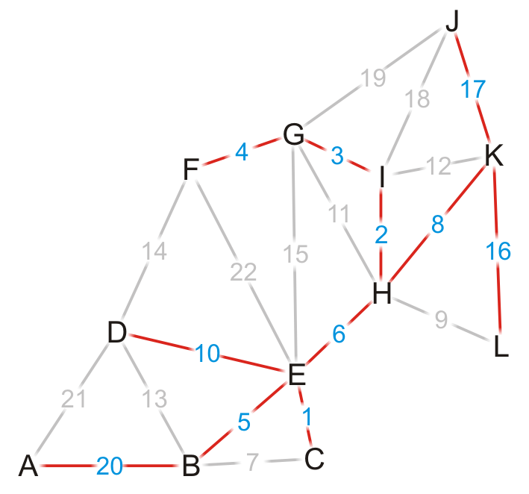
Example
Using the previous pointers, we can reconstruct the paths
Vertex | Visited | Distance | Previous
A | T | 39 | B
B | T | 19 | E
C | T | 15 | E
D | T | 24 | E
E | T | 14 | H
F | T | 17 | G
G | T | 13 | I
H | T | 8 | K
I | T | 10 | H
J | T | 17 | K
K | T | 0 | Ø
L | T | 16 | K

Slide 59
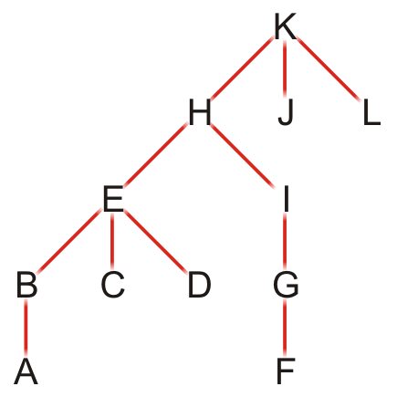
Example
Note that this table defines a rooted parental tree.
The source vertex K is at the root.
The previous pointer is the parent of the vertex in the tree
Vertex | Previous
A | B
B | E
C | E
D | E
E | H
F | G
G | I
H | K
I | H
J | K
K | Ø
L | K

Slide 60
Comments on Dijkstra’s algorithm
Questions:
What if at some point, all unvisited vertices have a distance ∞?
This means that the graph is unconnected
We have found the shortest paths to all vertices in the connected subgraph containing the source vertex
What if we just want to find the shortest path between vertices v_{j} and v_{k}?
Apply the same algorithm, but stop when we are visiting vertex v_{k}
Does the algorithm change if we have a directed graph?
No

Slide 61
Implementation and analysis
The initialization requires Ο(|V|) memory and run time
We iterate |V| – 1 times, each time finding the unvisited closest vertex
Iterating through the table requires is Ο(|V|) time
Each time we find a vertex, we must check all of its neighbors
With an adjacency matrix, the run time is Ο(|V|(|V| + |V|)) = Ο(|V|²)
With an adjacency list, the run time is Ο(|V|² + |E|) = Ο(|V|²) as |E| = O(|V|²)
Can we do better?
Recall, we only need the vertex with the shortest distance next. We can use min-heap similar as the Prim’s algorithm.
Notes:
We can use min heap based optimization just like in Prim’s algorithm.

Slide 62
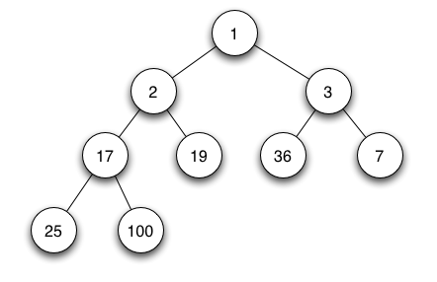
Min-heap-based optimization
a min heap
The initialization requires Ο(|V|) memory and run time
The min heap requires Ο(|V|) memory which contains the shortest distance of all the vertices from the source vertex
We iterate |V| times, each time finding the unvisited closest vertex to the source
Obtain the shortest distance from the min heap O(1), maintain the heap O(log(|V|))
The work required for this is O(|V| log(|V|))
Is this all the work that is necessary?
Recall that for the closest vertex in an iteration, we try to update the distance of all its neighbors, thus there are O(|E|) updates in total and each update in the heap requires O(log(|V|)).
Thus, the work required for this is O(|E| log(|V|))
Thus, the total run time is O(|V| log(|V|) + |E| log(|V|)) = O(|E| log(|V|))
Notes:
The min-heap serves as a priority queue here.

Slide 63
Quick Exercise
Given the graph below, apply Dijkstra’s Algorithm to find the shortest paths from S.
A
3
T
Vertex | Visited | Distance | Previous
A | F | ∞ | Ø
B | F | ∞ | Ø
C | F | ∞ | Ø
D | F | ∞ | Ø
E | F | ∞ | Ø
S | T | 0 | Ø
T | F | ∞ | Ø
2
$$2√2$$
3
B
1
C
1
1
S
D
E
1
2

Slide 64
Quick Exercise
A
3
T
Vertex | Visited | Distance | Previous
A | F | ∞ | Ø
B | F | ∞ | Ø
C | F | ∞ | Ø
D | F | ∞ | Ø
E | F | ∞ | Ø
S | T | 0 | Ø
T | F | ∞ | Ø
2
$$2√2$$
3
B
1
C
1
1
S
D
E
1
2

Slide 65
Quick Exercise
A
3
T
Vertex | Visited | Distance | Previous
A | F | ∞ | Ø
B | F | 1 | S
C | F | ∞ | Ø
D | F | 1 | S
E | F | ∞ | Ø
S | T | 0 | Ø
T | F | ∞ | Ø
2
$$2√2$$
3
B
1
C
1
1
S
D
E
1
2

Slide 66
Quick Exercise
A
3
T
Vertex | Visited | Distance | Previous
A | F | ∞ | Ø
B | T | 1 | S
C | F | ∞ | Ø
D | F | 1 | S
E | F | ∞ | Ø
S | T | 0 | Ø
T | F | ∞ | Ø
2
$$2√2$$
3
B
1
C
1
1
S
D
E
1
2

Slide 67
Quick Exercise
A
3
T
Vertex | Visited | Distance | Previous
A | F | ∞ | Ø
B | T | 1 | S
C | F | ∞ | Ø
D | F | 1 | S
E | F | ∞ | Ø
S | T | 0 | Ø
T | F | ∞ | Ø
2
$$2√2$$
3
B
1
C
1
1
S
D
E
1
2

Slide 68
Quick Exercise
A
3
T
Vertex | Visited | Distance | Previous
A | F | 3 | B
B | T | 1 | S
C | F | 2 | B
D | F | 1 | S
E | F | ∞ | Ø
S | T | 0 | Ø
T | F | ∞ | Ø
2
$$2√2$$
3
B
1
C
1
1
S
D
E
1
2

Slide 69
Quick Exercise
A
3
T
Vertex | Visited | Distance | Previous
A | F | 3 | B
B | T | 1 | S
C | F | 2 | B
D | T | 1 | S
E | F | ∞ | Ø
S | T | 0 | Ø
T | F | ∞ | Ø
2
$$2√2$$
3
B
1
C
1
1
S
D
E
1
2

Slide 70
Quick Exercise
A
3
T
Vertex | Visited | Distance | Previous
A | F | 3 | B
B | T | 1 | S
C | F | 2 | B
D | T | 1 | S
E | F | ∞ | Ø
S | T | 0 | Ø
T | F | ∞ | Ø
2
$$2√2$$
3
B
1
C
1
1
S
D
E
1
2

Slide 71
Quick Exercise
A
3
T
Vertex | Visited | Distance | Previous
A | F | 3 | B
B | T | 1 | S
C | F | 2 | B
D | T | 1 | S
E | F | 3 | D
S | T | 0 | Ø
T | F | ∞ | Ø
2
$$2√2$$
3
B
1
C
1
1
S
D
E
1
2

Slide 72
Quick Exercise
A
3
T
Vertex | Visited | Distance | Previous
A | F | 3 | B
B | T | 1 | S
C | T | 2 | B
D | T | 1 | S
E | F | 3 | D
S | T | 0 | Ø
T | F | ∞ | Ø
2
$$2√2$$
3
B
1
C
1
1
S
D
E
1
2

Slide 73
Quick Exercise
A
3
T
Vertex | Visited | Distance | Previous
A | F | 3 | B
B | T | 1 | S
C | T | 2 | B
D | T | 1 | S
E | F | 3 | D
S | T | 0 | Ø
T | F | ∞ | Ø
2
$$2√2$$
3
B
1
C
1
1
S
D
E
1
2

Slide 74
Quick Exercise
A
3
T
Vertex | Visited | Distance | Previous
A | F | 3 | B
B | T | 1 | S
C | T | 2 | B
D | T | 1 | S
E | F | 3 | D
S | T | 0 | Ø
T | F | 2+$2√2$ | C
2
$$2√2$$
3
B
1
C
1
1
S
D
E
1
2

Slide 75
Quick Exercise
A
3
T
Vertex | Visited | Distance | Previous
A | T | 3 | B
B | T | 1 | S
C | T | 2 | B
D | T | 1 | S
E | F | 3 | D
S | T | 0 | Ø
T | F | 2+$2√2$ | C
2
$$2√2$$
3
B
1
C
1
1
S
D
E
1
2

Slide 76
Quick Exercise
A
3
T
Vertex | Visited | Distance | Previous
A | T | 3 | B
B | T | 1 | S
C | T | 2 | B
D | T | 1 | S
E | F | 3 | D
S | T | 0 | Ø
T | F | 2+$2√2$ | C
2
$$2√2$$
3
B
1
C
1
1
S
D
E
1
2

Slide 77
Quick Exercise
A
3
T
Vertex | Visited | Distance | Previous
A | T | 3 | B
B | T | 1 | S
C | T | 2 | B
D | T | 1 | S
E | T | 3 | D
S | T | 0 | Ø
T | F | 2+$2√2$ | C
2
$$2√2$$
3
B
1
C
1
1
S
D
E
1
2

Slide 78
Quick Exercise
A
3
T
Vertex | Visited | Distance | Previous
A | T | 3 | B
B | T | 1 | S
C | T | 2 | B
D | T | 1 | S
E | T | 3 | D
S | T | 0 | Ø
T | F | 2+$2√2$ | C
2
$$2√2$$
3
B
1
C
1
1
S
D
E
1
2

Slide 79
Quick Exercise
A
3
T
Vertex | Visited | Distance | Previous
A | T | 3 | B
B | T | 1 | S
C | T | 2 | B
D | T | 1 | S
E | T | 3 | D
S | T | 0 | Ø
T | T | 2+$2√2$ | C
2
$$2√2$$
3
B
1
C
1
1
S
D
E
1
2

Slide 80
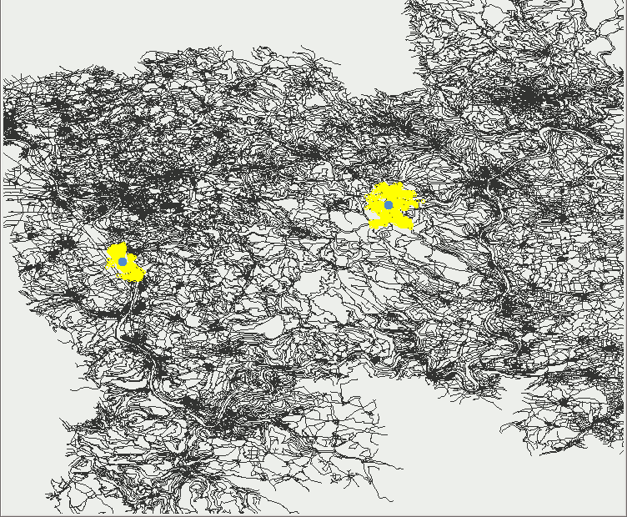
Summary for Dijkstra’s algorithm
Single source shortest distance/path for weighted graphs
Compute shortest distance/path for a pair of vertices in practice:
Bidirectional search

Slide 81
A* Search

Slide 82
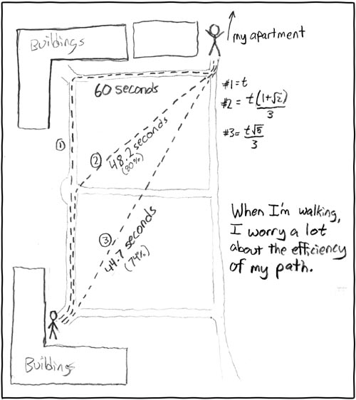
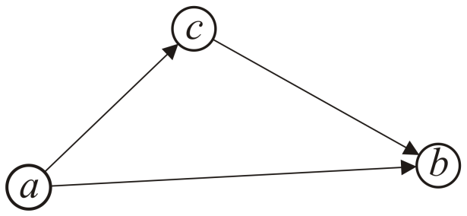
Motivation: Triangle Inequality
Starting from a specific starting node of a graph, if we aim to find the shortest path to a given goal node.
We can use the A* search which is faster than Dijkstra’s algorithm, which uses a hypothetical shortest distance to weight the paths.
The requirement is that the distances satisfy the triangle inequality, that is, the distance between a and b is less than the distance from a to c plus the distance from c to b.
All Euclidean distances satisfy the triangle inequality
http://xkcd.com/85/
Notes:
Triangle inequality is often true on geological situations. A* (pronounced ‘A-star’) is a search algorithm that finds the shortest path between some nodes S and T in a graph. A* is an informed search algorithm, or a best-first search, meaning that it is formulated in terms of weighted graphs: starting from a specific starting node of a graph, it aims to find a path to the given goal node having the smallest cost (least distance travelled, shortest time, etc.).

Slide 83
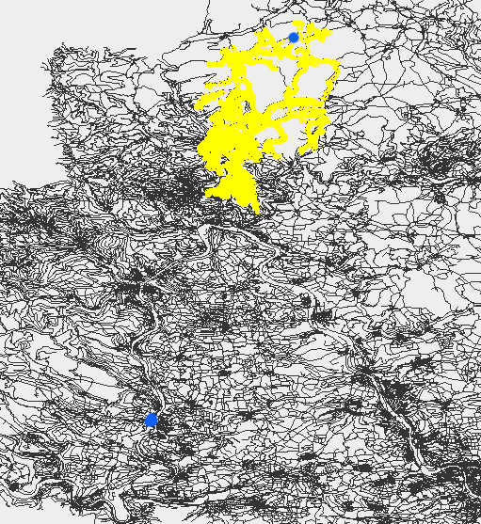
A quick view of A* search

Slide 84
Background
Assume we have a heuristic lower bound for the length of a path between any two vertices.
For instance, for a graph embedded in a plane, the shortest distance is the Euclidean distance. We can use this to guide our search for a path.
Notes:
If we want to get to node T from source S.
We are currently at node v.
The heuristic function estimate how “far away” v is from T.

Slide 85
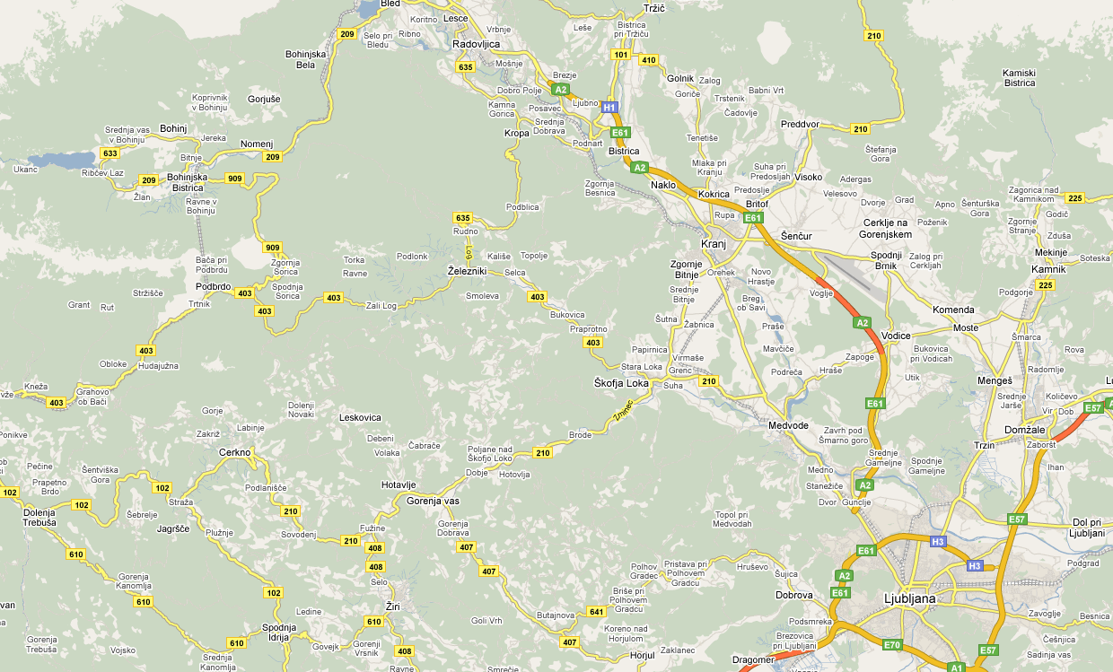
Idea
Consider this map of Slovenia

Slide 86
Idea
Suppose we want to go from Kamnik to Bohinj

Slide 87
Idea
A lower bound for the length of the shortest path to Bohinj is h(Kamnik, Bohinj) = 53 km
53 km

Slide 88
Idea
Any actual path must be at least as long as 53 km
53 km

Slide 89
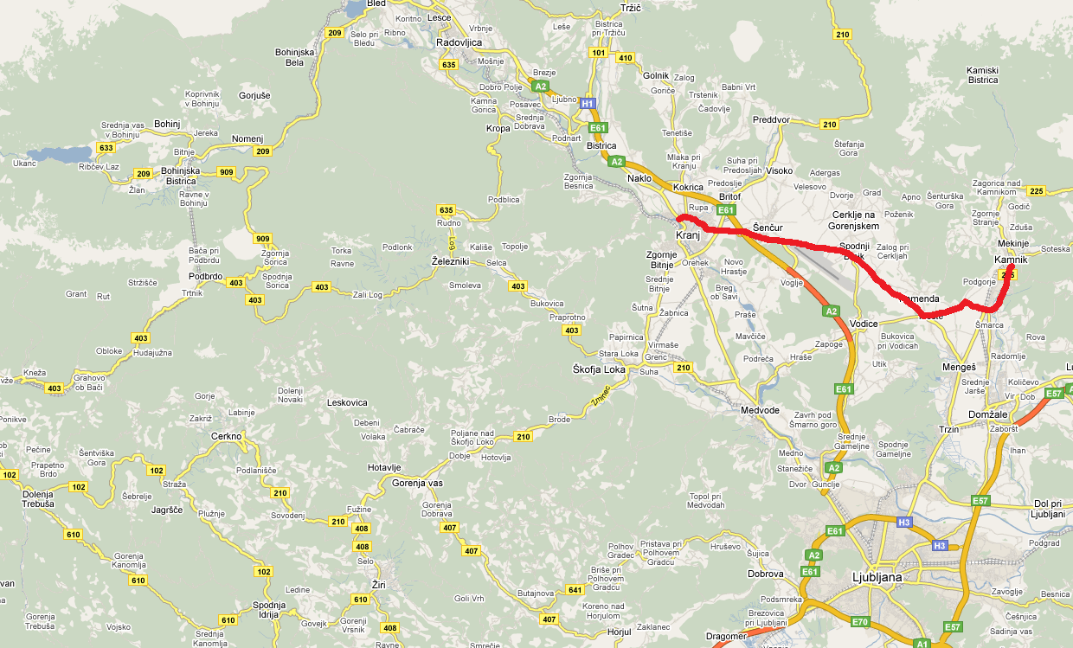
Idea
Suppose we have a 28 km shortest path from Kamnik to Kranj: d(Kamnik, Kranj) = 28 km
28 km

Slide 90
Idea
A lower bound on the shortest distance from Kranj to the destination is now h(Kranj, Bohinj) = 32 km
32 km
28 km

Slide 91
Idea
Thus, we weight of the path up to Kranj is
w(Kranj) = d(Kamnik, Kranj) + h(Kranj, Bohinj) = 60 km
32 km
28 km

Slide 92
Idea
Any path extending this given path to Bohimj must be at least 60 km
32 km
28 km

Slide 93
Idea
The value w(Kranj) represents the shortest possible distance from Kamnik to Bohinj given that we follow the path to Kranj
As with Dijkstra’s algorithm, we must start with the null path starting at Kamnik:
w(Kamnik) = d(Kamnik, Kamnik) + h(Kamnik, Bohimj)
= 0 km + 53 km
Bohimj
53 km
Kamnik

Slide 94
Algorithm Description
Suppose we are finding the shortest path from vertex a to a vertex z
The A* search algorithm initially:
Marks each vertex as unvisited
Starts with an array containing only the initial vertex
The value of any vertex v in the array is the weight w(v) which assumes we have found the a shortest path to v

Slide 95
Algorithm Description
The algorithm then iterates:
Visit the vertex u with the least weight
Mark the vertex u of the path as visited
Ignore all visited adjacent vertices v
For each remaining unvisited adjacent vertex v:
Determine if w(v) = d(a, u) + d(u, v) + h(v, z) is less than the current weight of v, and if so, update the path leading to v and its weight
Continue iterating until the destination vertex z is visited

Slide 96
Comparison with Dijkstra’s Algorithm
This differs from Dijkstra’s algorithm which gives weight only to the known path
Difference:
Dijkstra’s algorithm radiates out from the initial vertex
The A* search algorithm directs its search towards the destination

Slide 97
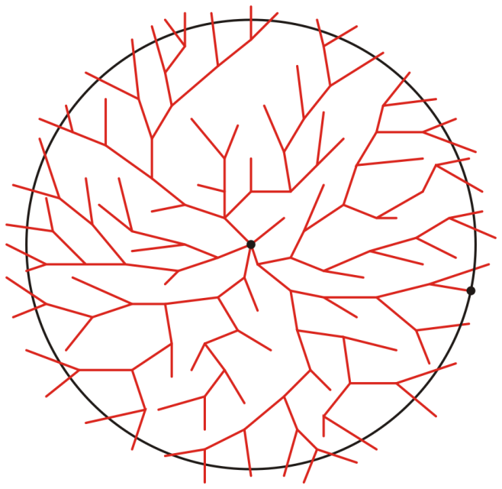
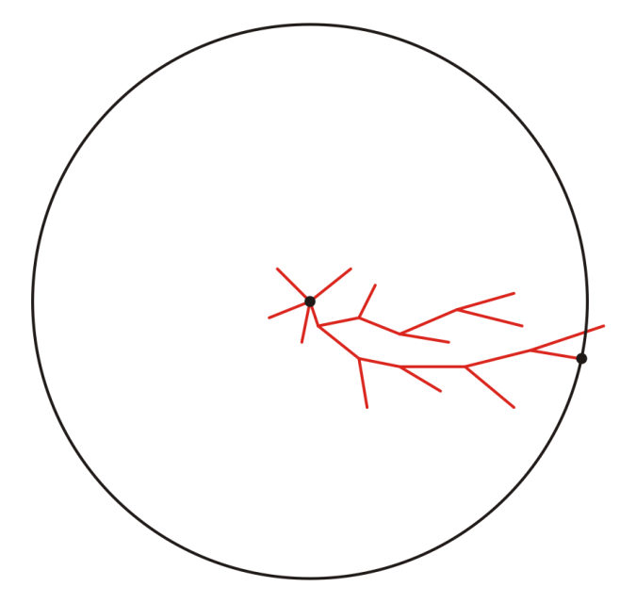
Comparison with Dijkstra’s Algorithm
Graphically, we can suggest the behaviour of the two algorithms as follows:
Suppose we are moving from a to z:
a
a
z
z
Representative search patterns for Dijkstra’s and the A* search algorithms
Notes:
When the heuristic function is set to be the discrete distance, then A* becomes the Dijkstra’s algorithm.
This is because the discrete distance function does not provide helpful information about
“how far away” a vertex is from the target vertex. It always returns one if the target vertex has not been reached.
Here is a representative search pattern for the two algorithms:
Dijkstra expand from the source node, with no information directing it.
A* search uses the heuristic function to supervise its vertex exploration.
Interested reader:
https://www.youtube.com/watch?v=g024lzsknDo

Slide 98
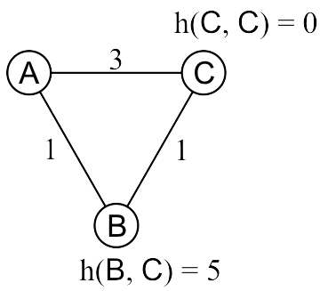
Optimally Guarantees?
The A* search algorithm will NOT always find the optimal path with a poor heuristic distance
Find the shortest path from A to C:
w(B) = 1 + 5 = 6
w(C) = 3 + 0 = 3
Therefore, C is visited next and as it is the destination, we are finished
Notes:
A* algorithm relies heavily on the design of the heuristic function.
Ideally, we want the heuristic function to be exactly the shortest distance from the vertex we are visiting to the target vertex.
However, this is not possible.
Here is an example of how a bad heuristic will confuse the algorithm and lead to a not-optimal path.
If we want the shortest path from A to C, in this example, we need to compare the path A -> C and A -> B -> C.
The weight of vertex C is 3, because the h(C, C) is always zero.
The weight of vertex B is the length of AB added to the estimated distance from B to C, which is over-estimated to be 5.
In this case, the A* algorithm prefers to explore vertex C directly and terminates.
98

Slide 99
Admissible Heuristics
This heuristic overestimates the actual distance from B to C.
The Euclidean distance doesn’t suffer this problem:
The path the crow flies is always shorter than the road the wolf runs.
Notes:
The Euclidean distance is usually a good choice, for road networks.
On a two-D plane, the Euclidean distance is the length of the line segment between two points.
99

Slide 100
Admissible Heuristics
Admissible heuristics h:
Let d(u, v) represent the actual shortest distance from u to v
A heuristic h(u, v) is admissible if h(u, v) ≤ d(u, v)
The heuristic is optimistic or a lower bound on the distance
When the heuristic is admissible, then it is guaranteed to return the shortest path.
Using the Euclidean distance between two points on a map is clearly an admissible heuristic
The flight of the crow is shorter than the run of the wolf
Notes:
When the heuristic function over-estimate the distance, then A* is not guaranteed to find the optimal path.
A heuristic function is admissible if it never overestimates the distance to the goal.
When the heuristic is admissible, then it is guaranteed to return the shortest path.
100

Slide 101
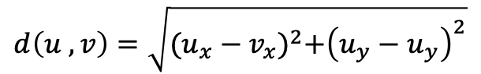
Quick Exercise
A
3
T
Given the graph, apply A* Algorithm to find the shortest path from S to T. Use Euclidean distance as the heuristic.
2
$$2√2$$
3
$$d\left(u ,v\right)=\sqrt{{(u_{x}−v_{x})}^{2}+{\left(u_{y}−u_{y}\right)}^{2}}$$
B
2.1
C
The coordinates of the vertices:
A = (0, 3)
B = (0, 1)
C = (1, 1)
D = (1, 0)
E = (3, 0)
S = (0, 0)
T = (3, 3)
1
2.1
S
D
E
1
2
Vertex | Visited | Distance | Heuristic | Total | Previous
A | F | ∞ | 3 | ∞ | Ø
B | F | ∞ | $$√13$$ | ∞ | Ø
C | F | ∞ | $$2√2$$ | ∞ | Ø
D | F | ∞ | $$√13$$ | ∞ | Ø
E | F | ∞ | 3 | ∞ | Ø
S | T | 0 | $$3√2$$ | $$3√2$$ | Ø
T | F | ∞ | 0 | ∞ | Ø
Notes:
Here is a quick exercise to Apply A* to find the shortest path from S to T.
The heuristic function supplied here is the Euclidean distance.
The vertices lie on a 2-Dimensional plan, with given coordinates.
In this table, for each vertex we initialize its distance to be infinity and mark them as unvisited.
The heuristic is calculated as the Euclidean distance from the vertex to the target T.
In each iteration, we compute the weight of each vertex as the sum of the distance and heuristic (denoted by total here).
And in the next iteration, we poll the vertex with the minimum weight (total) to visit.
First, we visit vertex S and mark its distance to be 0.

Slide 102
Quick Exercise
Since S has the minimum weight, we update the distances of its neighbors B and D.
A
3
T
Vertex | Visited | Distance | Heuristic | Total | Previous
A | F | ∞ | 3 | ∞ | Ø
B | F | ∞ | $$√13$$ | ∞ | Ø
C | F | ∞ | $$2√2$$ | ∞ | Ø
D | F | ∞ | $$√13$$ | ∞ | Ø
E | F | ∞ | 3 | ∞ | Ø
S | T | 0 | $$3√2$$ | $$3√2$$ | Ø
T | F | ∞ | 0 | ∞ | Ø
2
$$2√2$$
3
B
2.1
C
1
2.1
S
D
E
1
2
Notes:
Since S has the minimum weight, we update the distances of its neighbors B and D.

Slide 103
Quick Exercise
The distances of B and D are updated. They now have the smallest weights (total).
Next, we visit B.
A
3
T
Vertex | Visited | Distance | Heuristic | Total | Previous
A | F | ∞ | 3 | ∞ | Ø
B | F | 1 | $$√13$$ | 1+$√13$ | S
C | F | ∞ | $$2√2$$ | ∞ | Ø
D | F | 1 | $$√13$$ | 1+$√13$ | S
E | F | ∞ | 3 | ∞ | Ø
S | T | 0 | $$3√2$$ | $$3√2$$ | Ø
T | F | ∞ | 0 | ∞ | Ø
2
$$2√2$$
3
B
2.1
C
1
2.1
S
D
E
1
2
Notes:
The distances of B and D are updated. They now have the smallest weights (total).
Next, we visit B.

Slide 104
Quick Exercise
Mark B as visited.
Next, we update the distances of A and C.
A
3
T
Vertex | Visited | Distance | Heuristic | Total | Previous
A | F | ∞ | 3 | ∞ | Ø
B | T | 1 | $$√13$$ | 1+$√13$ | S
C | F | ∞ | $$2√2$$ | ∞ | Ø
D | F | 1 | $$√13$$ | 1+$√13$ | S
E | F | ∞ | 3 | ∞ | Ø
S | T | 0 | $$3√2$$ | $$3√2$$ | Ø
T | F | ∞ | 0 | ∞ | Ø
2
$$2√2$$
3
B
2.1
C
1
2.1
S
D
E
1
2
Notes:
Mark B as visited.
Next we update the distances of A and C.

Slide 105
Quick Exercise
After updating the distances and the weights, D has the minimum weight and will be visited next.
A
3
T
Vertex | Visited | Distance | Heuristic | Total | Previous
A | F | 3 | 3 | 6 | B
B | T | 1 | $$√13$$ | 1+$√13$ | S
C | F | 3.1 | $$2√2$$ | 3.1+$2√2$ | B
D | F | 1 | $$√13$$ | 1+$√13$ | S
E | F | ∞ | 3 | ∞ | Ø
S | T | 0 | $$3√2$$ | $$3√2$$ | Ø
T | F | ∞ | 0 | ∞ | Ø
2
$$2√2$$
3
B
2.1
C
1
2.1
S
D
E
1
2
Notes:
After updating the distances and the weights, D has the minimum weight and will be visited next.

Slide 106
Quick Exercise
Mark D as visited.
A
3
T
Vertex | Visited | Distance | Heuristic | Total | Previous
A | F | 3 | 3 | 6 | B
B | T | 1 | $$√13$$ | 1+$√13$ | S
C | F | 3.1 | $$2√2$$ | 3.1+$2√2$ | B
D | T | 1 | $$√13$$ | 1+$√13$ | S
E | F | ∞ | 3 | ∞ | Ø
S | T | 0 | $$2√3$$ | $$2√3$$ | Ø
T | F | ∞ | 0 | ∞ | Ø
2
$$2√2$$
3
B
2.1
C
1
2.1
S
D
E
1
2
Notes:
Mark D as visited.
Update the distances of C and E.

Slide 107
Quick Exercise
Update the distances of E.
A
3
T
Vertex | Visited | Distance | Heuristic | Total | Previous
A | F | 3 | 3 | 6 | B
B | T | 1 | $$√13$$ | 1+$√13$ | S
C | F | 3.1 | $$2√2$$ | 3.1+$2√2$ | B
D | T | 1 | $$√13$$ | 1+$√13$ | S
E | F | 3 | 3 | 6 | D
S | T | 0 | $$3√2$$ | $$3√2$$ | Ø
T | F | ∞ | 0 | ∞ | Ø
2
$$2√2$$
3
B
2.1
C
1
2.1
S
D
E
1
2
Notes:
Update the distances of C and E.

Slide 108
Quick Exercise
Mark C as visited.
Update the distances of C’s neighbor: T.
A
3
T
Vertex | Visited | Distance | Heuristic | Total | Previous
A | F | 3 | 3 | 6 | B
B | T | 1 | $$√13$$ | 1+$√13$ | S
C | T | 3.1 | $$2√2$$ | 3.1+$2√2$ | B
D | T | 1 | $$√13$$ | 1+$√13$ | S
E | F | 3 | 3 | 6 | D
S | T | 0 | $$3√2$$ | $$3√2$$ | Ø
T | F | ∞ | 0 | ∞ | Ø
2
$$2√2$$
3
B
2.1
C
1
2.1
S
D
E
1
2
Notes:
Mark C as visited.
Update the distances of C’s neighbor: T.

Slide 109
Quick Exercise
The target vertex is now found.
Note that in this exercise, the vertices A and E remain unvisited.
This is because they are pruned by the heuristic function.
The weight suggests that vertex C is guaranteed to be a better option to explore.
A
3
T
Vertex | Visited | Distance | Heuristic | Total | Previous
A | F | 3 | 3 | 6 | B
B | T | 1 | $$√13$$ | 1+$√13$ | S
C | T | 3.1 | $$2√2$$ | 3.1+$2√2$ | B
D | T | 1 | $$√13$$ | 1+$√13$ | S
E | F | 3 | 3 | 6 | D
S | T | 0 | $$3√2$$ | $$3√2$$ | Ø
T | T | 3.1+$2√2$ | 0 | 3.1+$2√2$ | C
2
$$2\sqrt{2}$$
3
B
2.1
C
1
2.1
S
D
E
1
2
Notes:
The target vertex is now found.
Mark T as visited.
Note that in this exercise, the vertices A and E remain unvisited.
This is because they are pruned by the heuristic function.
The weight suggests that vertex C is guaranteed to be a better option to explore.

Slide 110
All-pairs Shortest Path

Slide 111
All-pairs Shortest Path
This topic:
We will look at the Floyd-Warshall algorithm for:
Finding all shortest distances (the shortest distance between all pairs of nodes)
Finding the paths corresponding to these distances
We conclude by finding the transitive closure
Notes:
If we wanted to find the shortest path between all pairs of nodes, we could apply Dijkstra’s algorithm to each vertex:

Slide 112
Problem
Observation: Any algorithm that finds the shortest path between all pairs must consider, each pair of vertices; therefore, a lower bound on the execution would be O(|V|²).
We will look at the Floyd-Warshall algorithm.

Slide 113
Strategy
First, let’s consider only edges that connect vertices directly:
Here, w_{i,j} is the weight of the edge connecting vertices i and j
In C++, we would define a two-dimensional array
double d[num_vertices][num_vertices];

Slide 114
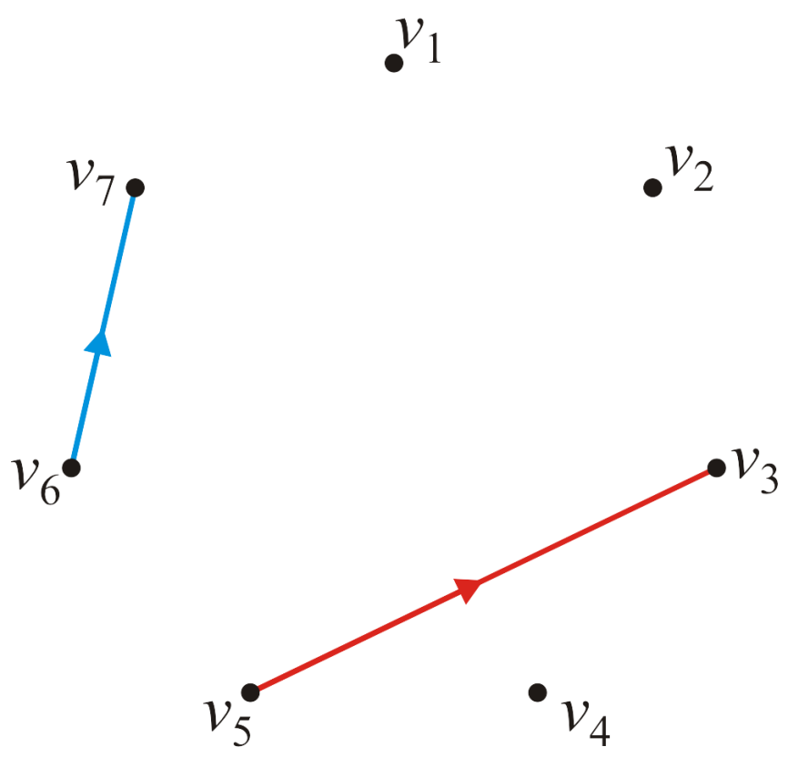
Strategy
Consider this graph of seven vertices
The edges defining the values and are highlighted

Slide 115
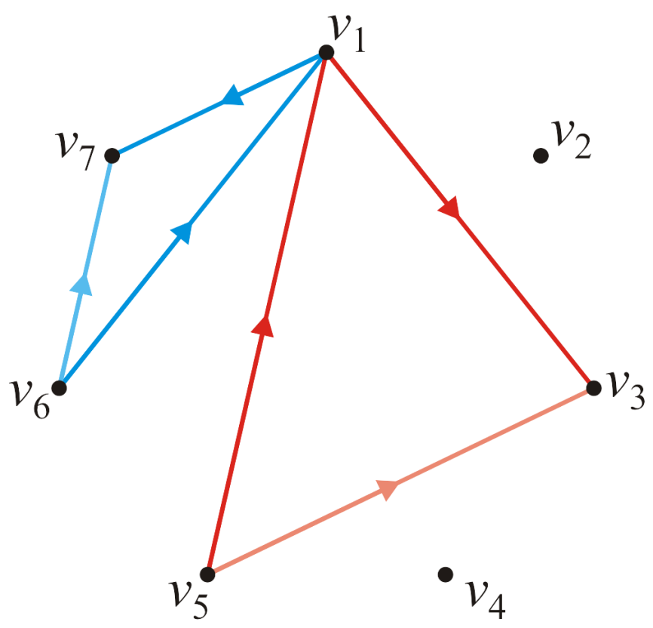
Strategy
Suppose now, we want to see whether or not the path going through vertex v₁ is shorter than a direct edge?
Is ?
Is ?

Slide 116
Strategy
Thus, for each pair of edges, we will define by calculating:

Slide 117
Strategy
Note that and ; thus, we need just run the algorithm for each pair of vertices:
for ( int i = 1; i <= n; ++i ) {
for ( int j = 1; j <= num_n; ++j ) {
d[i][j] = min( d[i][j], d[i][1] + d[1][j] );
}
}

Slide 118
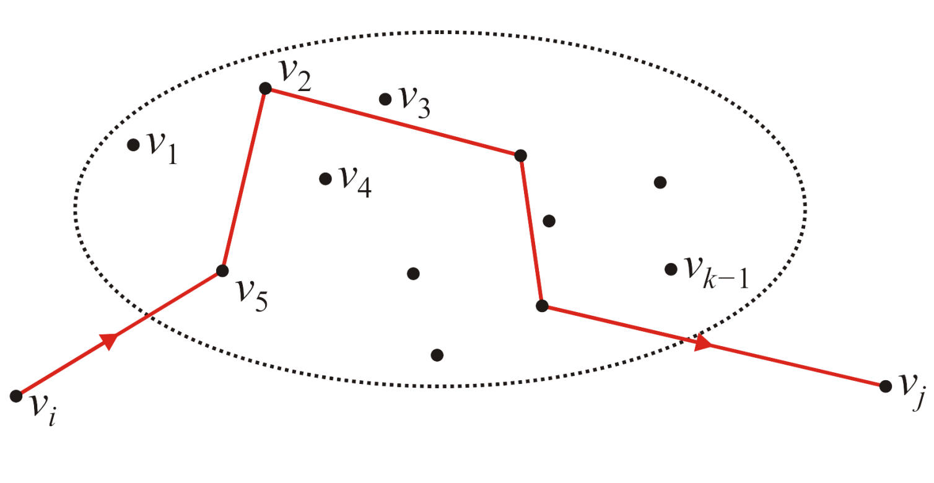
The General Step
Define as the shortest distance, but only allowing intermediate visits to vertices v₁, v₂, …, v_{k–1}
Suppose we have an algorithm that has found these values for all pairs

Slide 119
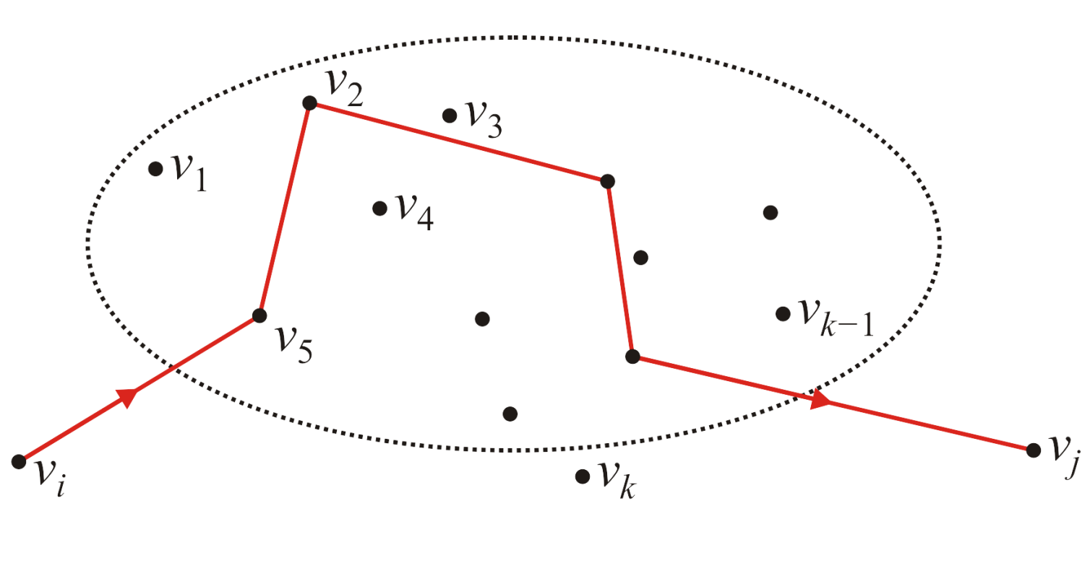
The General Step
How could we find ; that is, the shortest path allowing intermediate visits to vertices v₁, v₂, …, v_{k–1} , v_{k} ?

Slide 120
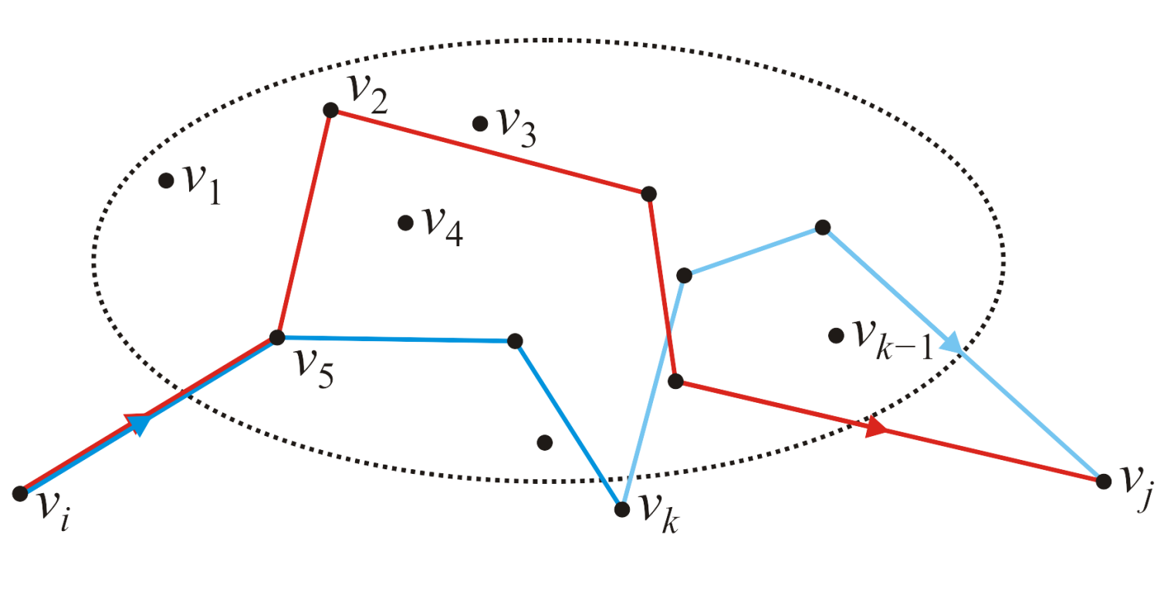
The General Step
With v₁, v₂, …, v_{k–1} as intermediates, have assumed we have found the shortest paths from v_{i} to v_{j}, v_{i} to v_{k} and v_{k} to v_{j .} The only possible shorter path including v_{k} would be the path from v_{i} to v_{k} continuing from there to v_{j}
Thus, we calculate

Slide 121
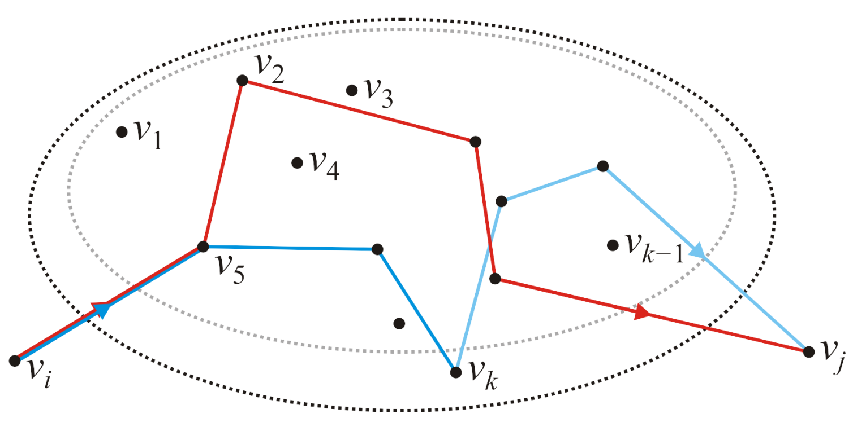
The General Step
Finding this for all pairs of vertices gives us all shortest paths from v_{i} to v_{j} possibly going through vertices v₁, v₂, …, v_{k}

Slide 122
The Floyd-Warshall Algorithm
Thus, we have found the Floyd-Warshall algorithm:
double d[num_vertices][num_vertices];
// Initialize the matrix d: Theta(|V|^2)
// ...
// Run Floyd-Warshall
for ( int k = 0; k < num_vertices; ++k ) {
for ( int i = 0; i < num_vertices; ++i ) {
for ( int j = 0; j < num_vertices; ++j ) {
d[i][j] = min( d[i][j], d[i][k] + d[k][j] );
}
}
}
Run time?
O(|V|³)

Slide 123
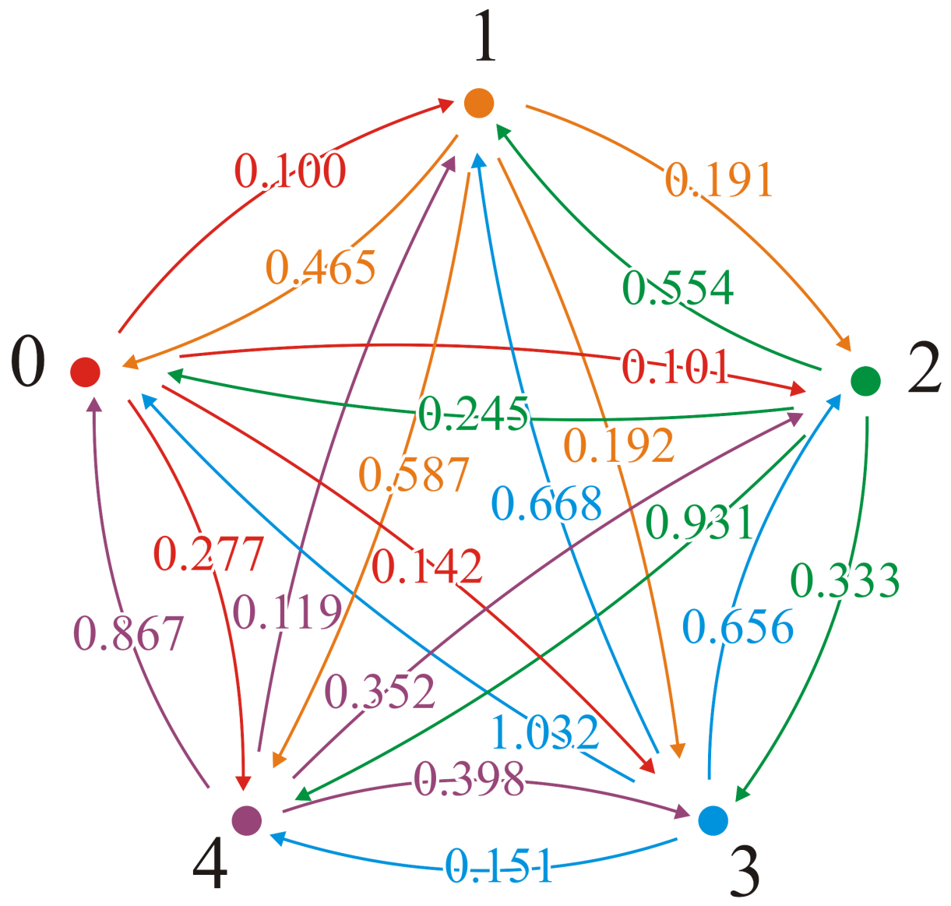
Example
Consider this graph
The adjacency matrix is
This would define our matrix D = (d_{ij})

Slide 124

Example
With the first pass, k = 1, we attempt passing through vertex v₁
We would start: (2, 3) → (2, 1, 3)
0.191 ≯ 0.465 + 0.101

Slide 125
Example
With the first pass, k = 1, we attempt passing through vertex v₁
We would start: (2, 4) → (2, 1, 4)
0.192 ≯ 0.465 + 0.142

Slide 126
Example
With the first pass, k = 1, we attempt passing through vertex v₁
We would start: (2, 5) → (2, 1, 5)
0.587 ≯ 0.465 + 0.277

Slide 127
Example
With the first pass, k = 1, we attempt passing through vertex v₁
Here is a shorter path: (3, 2) → (3, 1, 2)
0.554 > 0.245 + 0.100 = 0.345

Slide 128
Example
With the first pass, k = 1, we attempt passing through vertex v₁
We update the table (3, 2) → (3, 1, 2)
0.554 > 0.245 + 0.100 = 0.345

Slide 129
Example
With the first pass, k = 1, we attempt passing through vertex v₁
And a second shorter path: (3, 5) → (3, 1, 5)
0.931 > 0.245 + 0.277 = 0.522

Slide 130
Example
With the first pass, k = 1, we attempt passing through vertex v₁
We update the table

Slide 131
Example
With the first pass, k = 1, we attempt passing through vertex v₁
Continuing: (4, 2) → (4, 1, 2)
0.668 ≯ 1.032 + 0.100
In fact, no other shorter paths through vertex v₁ exist

Slide 132
Example
With the next pass, k = 2, we attempt passing through vertex v₂
There are three shorter paths: (5, 1) → (5, 2, 1)
0.867 > 0.119 + 0.465 = 0.584 (5, 3) → (5, 2, 3)
0.352 > 0.119 + 0.191 = 0.310
(5, 4) → (5, 2, 4)
0.398 > 0.119 + 0.192 = 0.311

Slide 133
Example
With the next pass, k = 2, we attempt passing through vertex v₂
We update the table

Slide 134
Example
With the next pass, k = 3, we attempt passing through vertex v₃
There are three shorter paths: (2, 1) → (2, 3, 1)
0.465 > 0.191 + 0.245 = 0.436 (4, 1) → (4, 3, 1)
1.032 > 0.656 + 0.245 = 0.901
(5, 1) → (5, 3, 1)
0.584 > 0.310 + 0.245 = 0.555

Slide 135
Example
With the next pass, k = 3, we attempt passing through vertex v₃
We update the table

Slide 136
Example
With the next pass, k = 4, we attempt passing through vertex v₄
There are two shorter paths: (2, 5) → (2, 4, 5)
0.587 > 0.192 + 0.151 (3, 5) → (3, 4, 5)
0.522 > 0.333 + 0.151

Slide 137
Example
With the next pass, k = 4, we attempt passing through vertex v₄
We update the table

Slide 138
Example
With the last pass, k = 5, we attempt passing through vertex v₅
There are three shorter paths: (4, 1) → (4, 5, 1)
0.901 > 0.151 + 0.555 = 0.706 (4, 2) → (4, 5, 2)
0.668 > 0.151 + 0.119 = 0.270
(4, 3) → (4, 5, 3)
0.656 > 0.151 + 0.310 = 0.461

Slide 139
Example
With the last pass, k = 5, we attempt passing through vertex v₅
We update the table

Slide 140
Example
Thus, we have a table of all shortest paths:

Slide 141
What Is the Shortest Path?
This algorithm finds the shortest distances, but what are the paths corresponding to those shortest distances?
Recall that with Dijkstra’s algorithm, we could find the shortest paths by recording the previous node.
You would start at the end and work your way back… (AKA. Back-tracking)

Slide 142
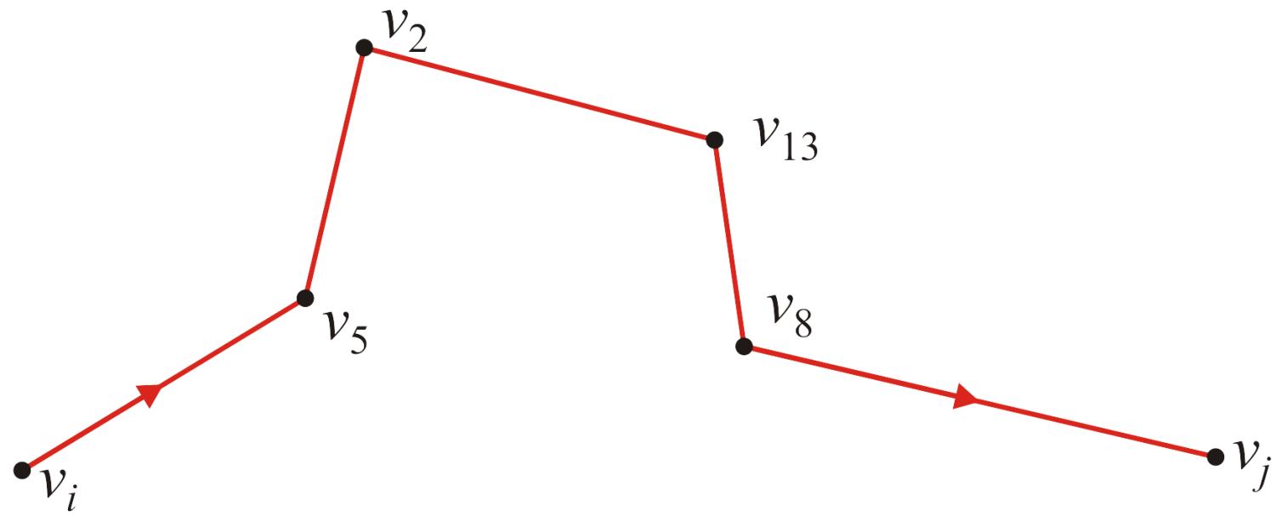
What Is the Shortest Path?
Suppose the shortest path from v_{i} to v_{j} is as follows:

Slide 143
What Is the Shortest Path?
Is this path consists of (v_{i}, v₅) and the shortest path from v₅ to v_{j}?
If there was a shorter path from v_{i} to v_{j} through v₅ that didn’t follow v₂, v₁₃, etc., then we would also find a shorter path from v₅ to v_{j}

Slide 144
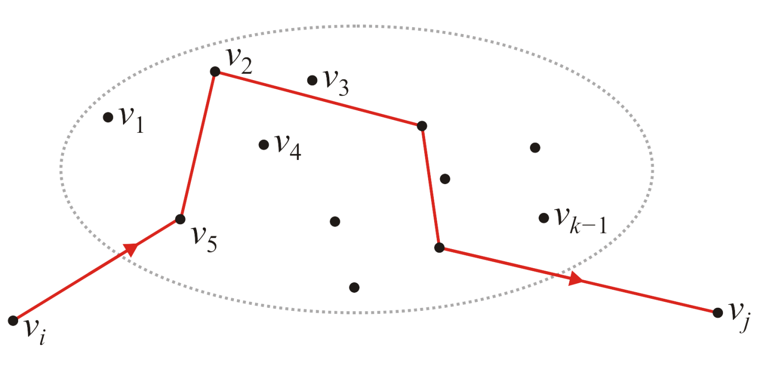
What Is the Shortest Path?
Now, suppose we have the shortest path from v_{i} to v_{j} which passes through the vertices v₁, v₂, …, v_{k–1}
In this example, the next vertex in the path is v₅

Slide 145
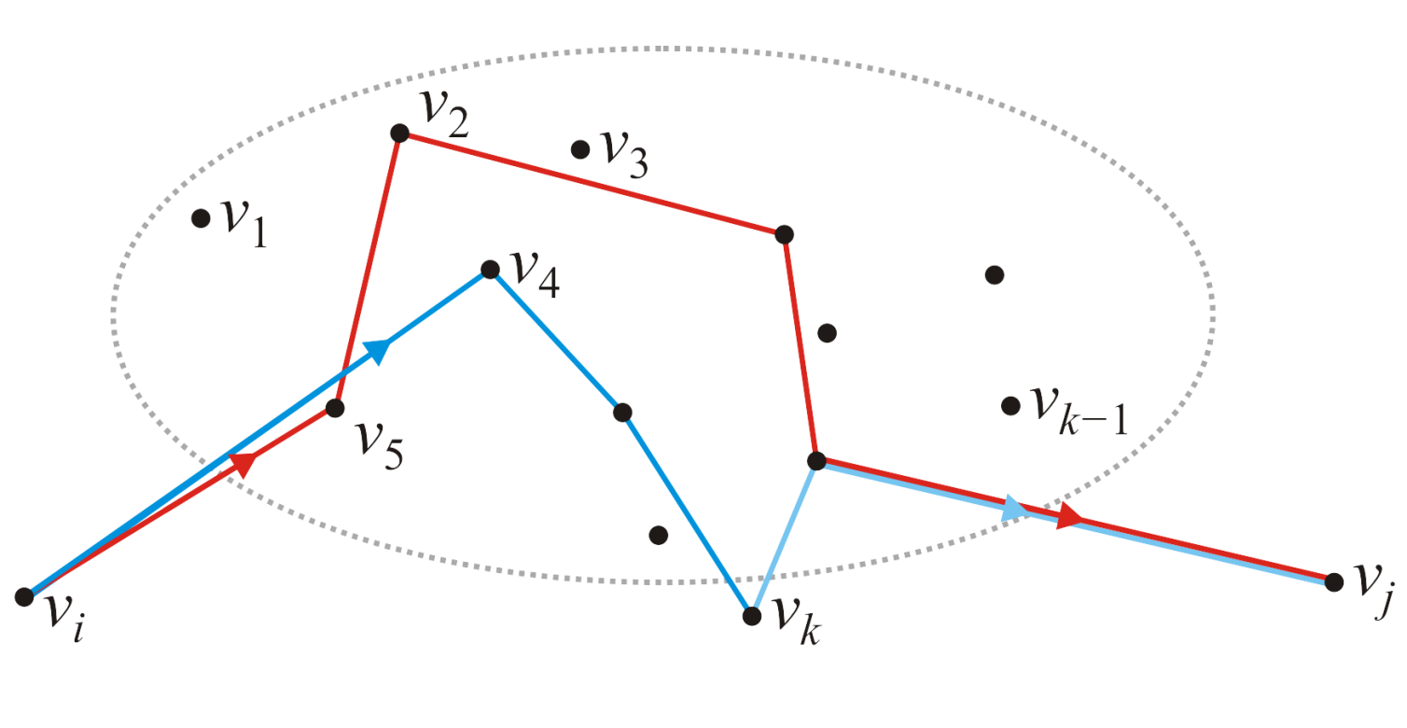
What Is the Shortest Path?
What if we find a shorter path passing through v_{k}?
In this example, all we’d have to do is now remember that the new path has v₄ as the second node—the rest of the path would be recursively stored as the shortest path from v₄ to v_{j}

Slide 146
What Is the Shortest Path?
In this case, let us store the shortest path moving forward.
P_{ij} stores the next vertex in the shortest path between i and j.
Initialize:
Now, if we find a shorter path, update the value
This matrix will store the next vertex in the list in the shortest path starting at vertex v_{i}

Slide 147
What Is the Shortest Path?
Thus, if we ever find a shorter path, update it the next node:
unsigned int p[num_vertices][num_vertices];
// Initialize the matrix p: O(|V|^2)
// ...
// Run Floyd-Warshall
for ( int k = 0; k < num_vertices; ++k ) {
for ( int i = 0; i < num_vertices; ++i ) {
for ( int j = 0; j < num_vertices; ++j ) {
if ( d[i][j] > d[i][k] + d[k][j] ) {
p[i][j] = p[i][k];
d[i][j] = d[i][k] + d[k][j];
}
}
}
}

Slide 148
Example
In our original example, initially, the next node is exactly that:
This would define our matrix P = (p_{ij})

Slide 149
Example
With the first pass, k = 1, we attempt passing through vertex v₁
There are two shorter paths: (3, 2) → (3, 1, 2)
0.554 > 0.245 + 0.100 (3, 5) → (3, 1, 5)
0.931 > 0.245 + 0.277

Slide 150
Example
With the first pass, k = 1, we attempt passing through vertex v₁
We update each of these

Slide 151
Example
After all the steps, we end up with the matrix P = (p_{i,j}):

Slide 152
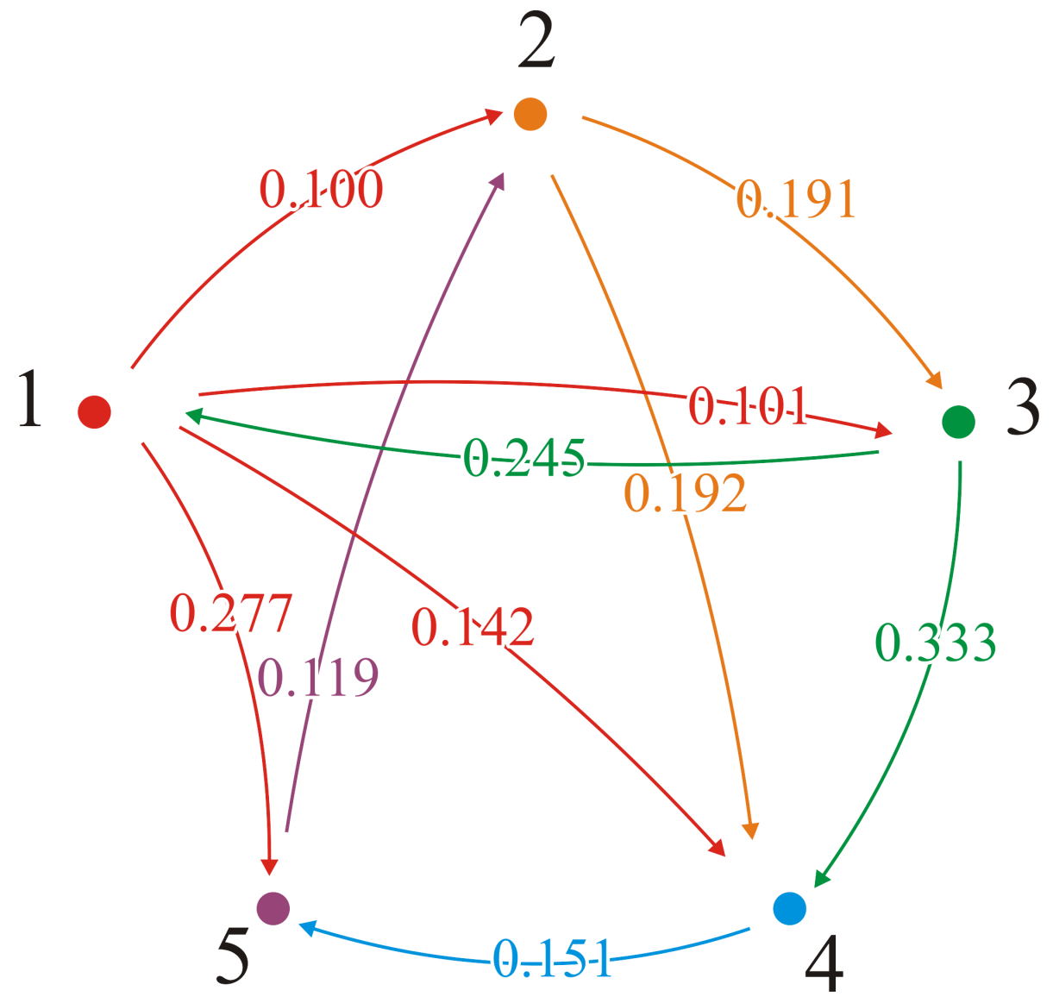
Example
These are all the adjacent edges that are still the shortest distance
For each of these, p_{i,j} = j

Slide 153
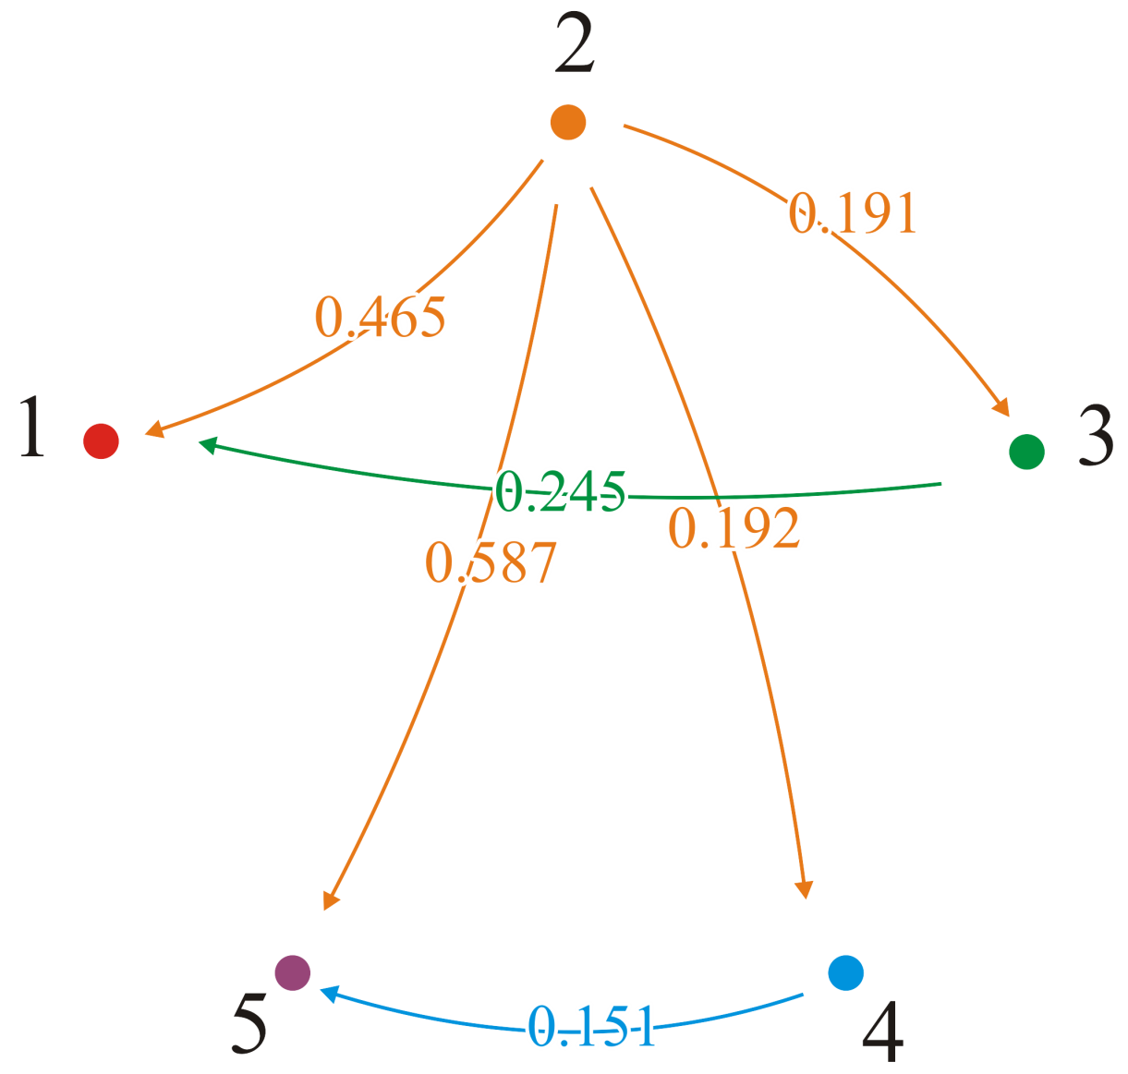
Example
From vertex v₂, p_{2,3} = 3 and p_{2,4} = 4; we go directly to vertices v₃ and v₄
But p_{2,1} = 3 and p_{3,1} = 1; the shortest path to v₁ is (2, 3, 1)
Also, p_{2,5} = 4 and p_{4,5} = 5; the shortest path to v₅ is (2, 4, 5)

Slide 154
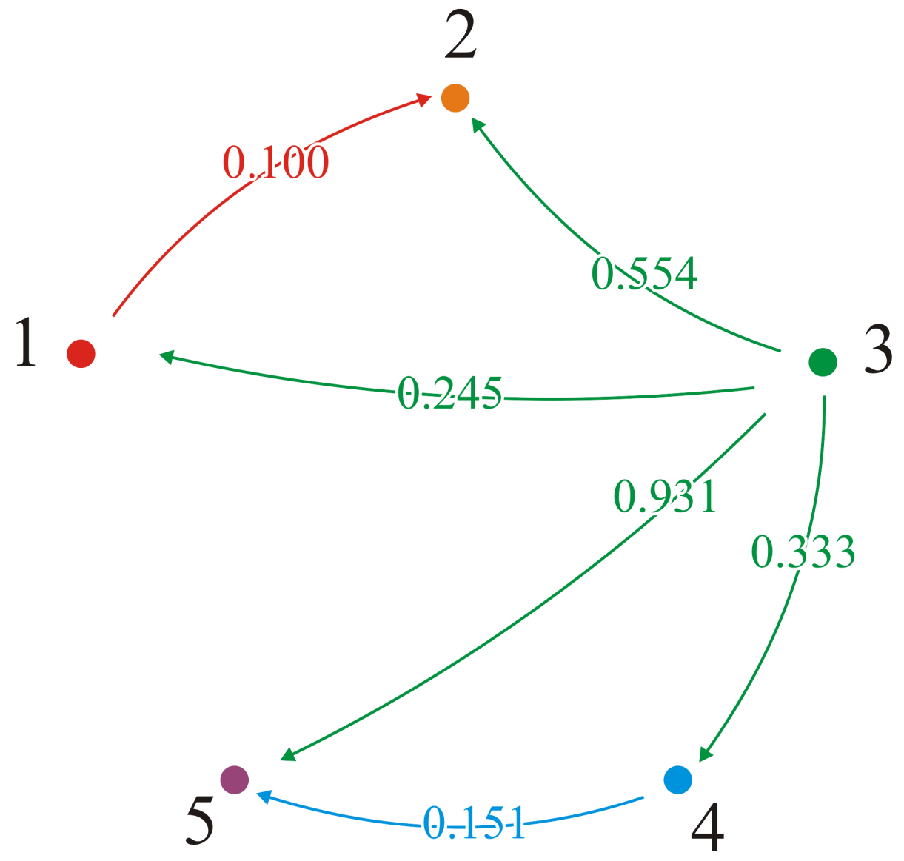
Example
From vertex v₃, p_{3,1} = 1 and p_{3,4} = 4; we go directly to vertices v₁ and v₄
But p_{3,2} = 1 and p_{1,2} = 2; the shortest path to v₂ is (3, 1, 2)
Also, p_{3,5} = 4 and p_{4,5} = 5; the shortest path to v₅ is (3, 4, 5)

Slide 155
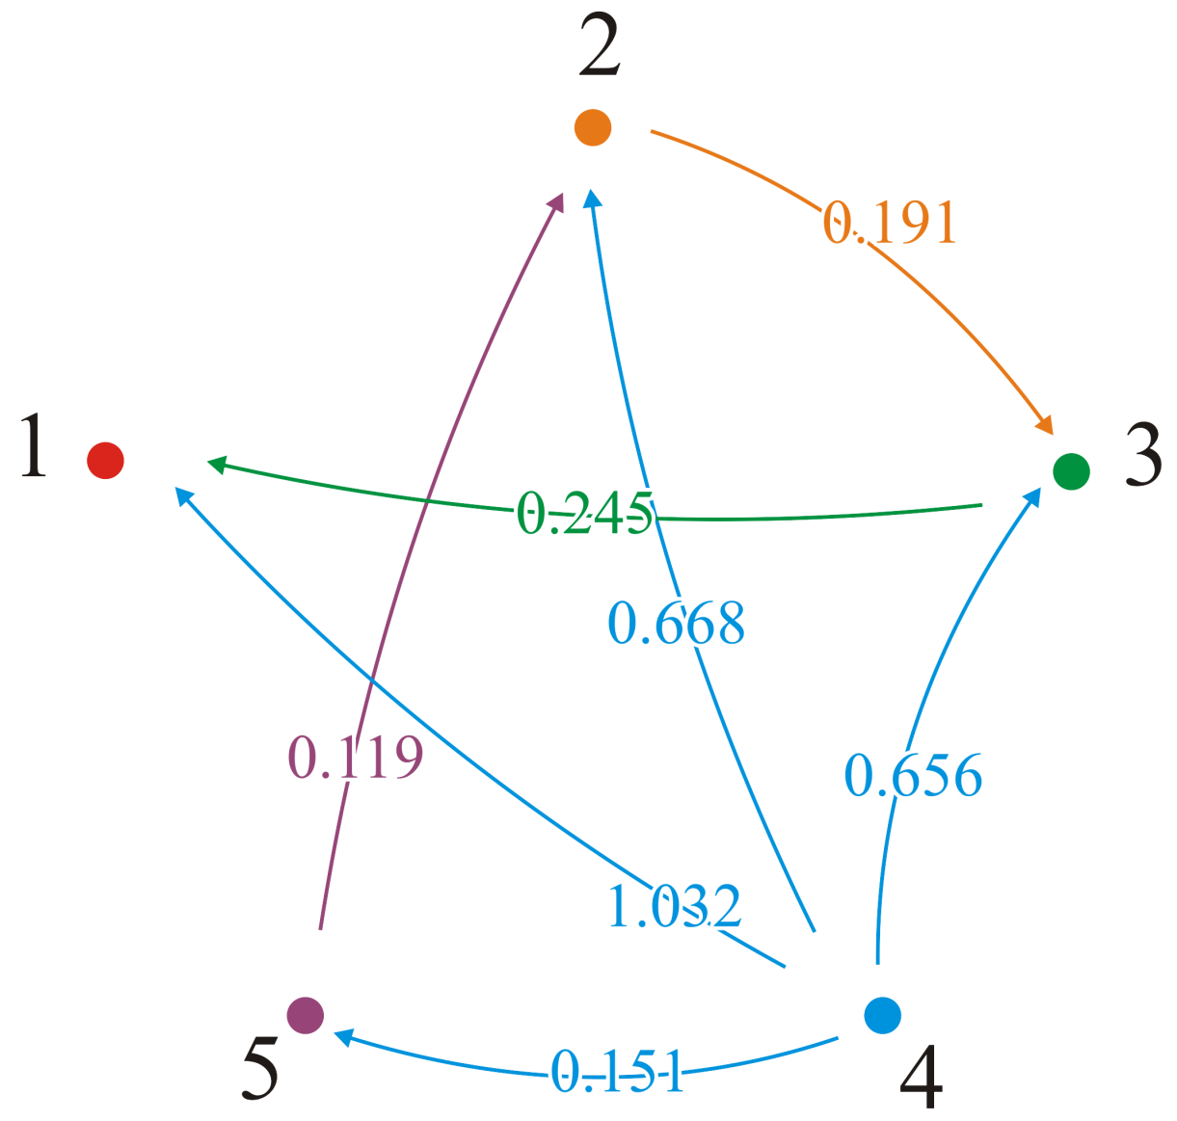
Example
From vertex v₄, p_{4,5} = 5; we go directly to vertex v₅
But p_{4,1} = 5, p_{5,1} = 2, p_{2,1} = 3, p_{3,1} = 1; the shortest path to v₁ is (4, 5, 2, 3, 1)

Slide 156
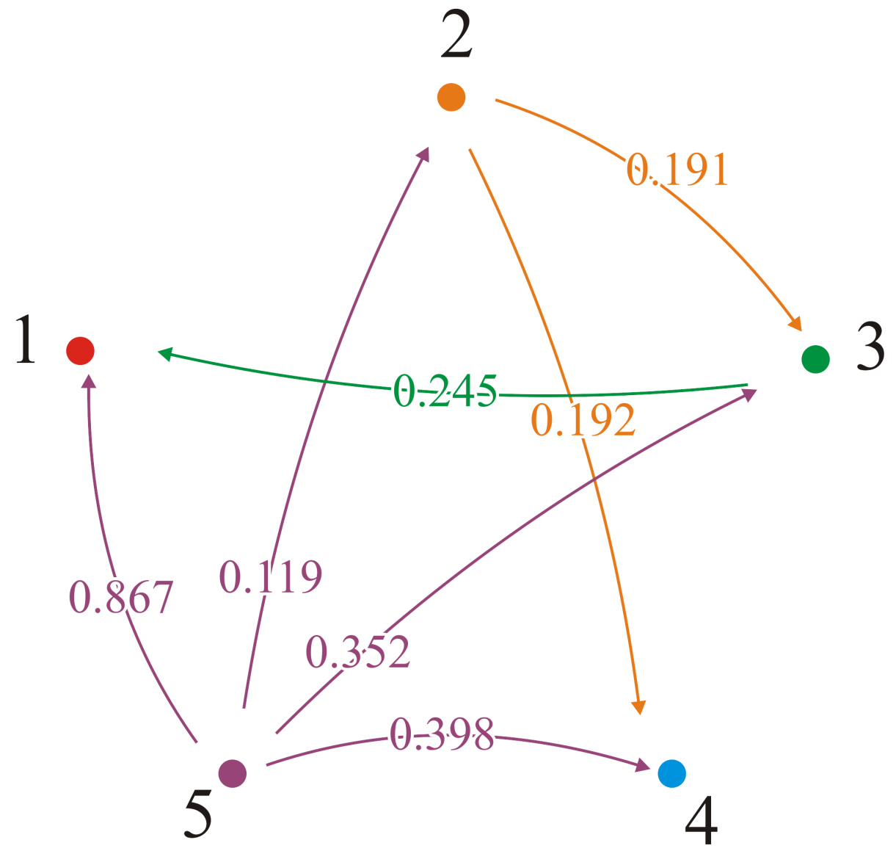
Example
From vertex v₅, p_{5,2} = 2; we go directly to vertex v₂
But p_{5,4} = 2 and p_{2,4} = 4; the shortest path to v₄ is (5, 2, 4)

Slide 157
Learning Outcome
Understand the Dijkstra’s algorithm, A* algorithm, and Floyd-Warshall algorithm.
Know how to use these algorithms to solve the shortest-path problems.

Slide 158
Index-based shortest distance

Slide 159
Drawbacks of online method
Drawbacks of online search methods (Dijkstra, A*…)
Takes much time if distance is long.
Explores too much unnecessary vertices.

Slide 160
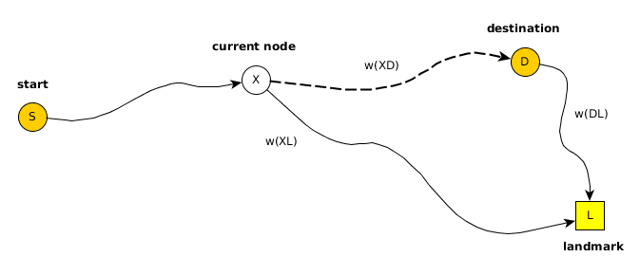
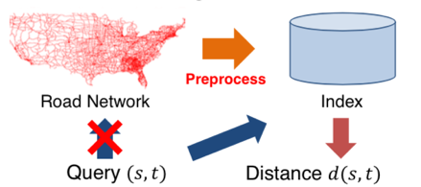
Index-based shortest distance
Further improve the query efficiency by precomputing small structure to maintain distances.
Landmark-based global summary structure.
Tree traversal.

Slide 161
What researchers are doing…
Different Index Structure (Maintenance for dynamic updates)
Shortest Distance vs Shortest Path
Shortest Path Counting & Enumeration
Various Settings (Distributed, Multi-Core . . .)
Complex Graphs (Road Networks, Social Networks . . .)
Variations (Label Constrained, Skyline . . .)
. . .

